Slide 1
AWS Certified DevOps Engineer
Professional Crash Course
With Robert Jordan

Slide 2
About Me

Slide 3
About this course
Exam focused
We cover theory and product specifics as needed to build skills needed for the exam.
Some features span multiple domains.
Based on my experiences. You mileage may vary!

Slide 4
About the exam
75 multiple choice and multi response questions
10 questions are not scored.
3 hours to complete
Cost $300 (USA)

Slide 5
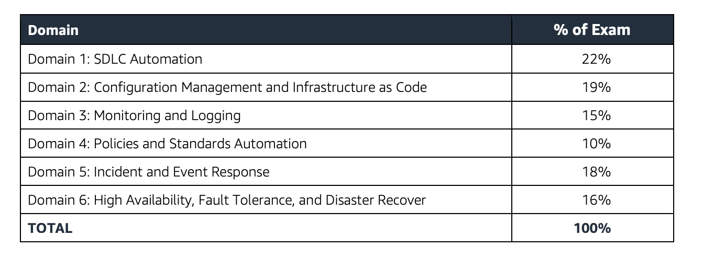
About the exam

Slide 6
SDLC Automation

Slide 7
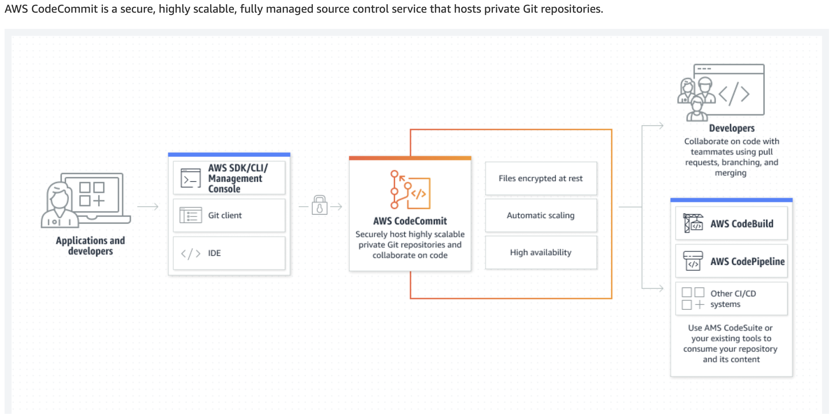
Amazon Code Commit

Slide 8
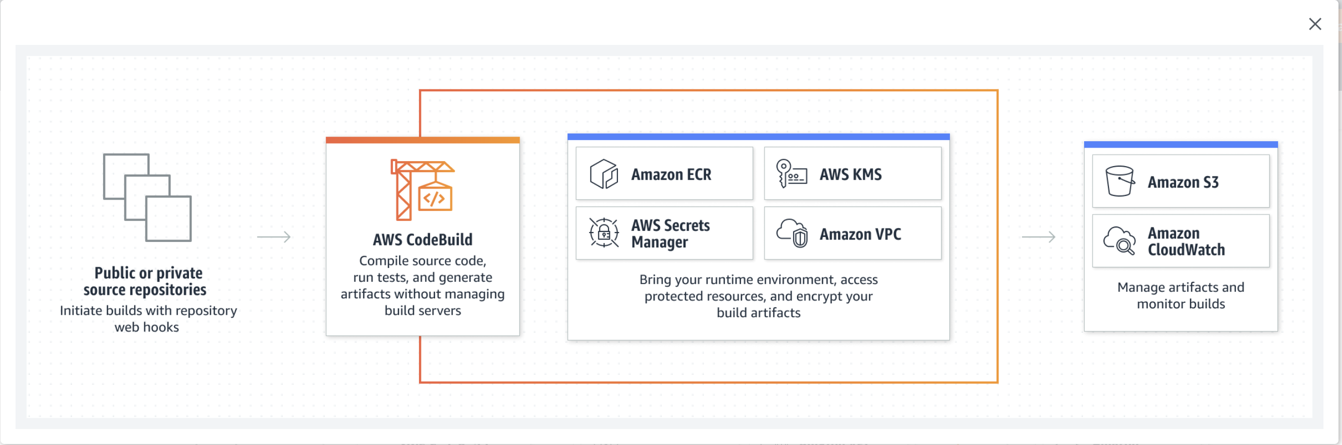
AWS CodeBuild

Slide 9
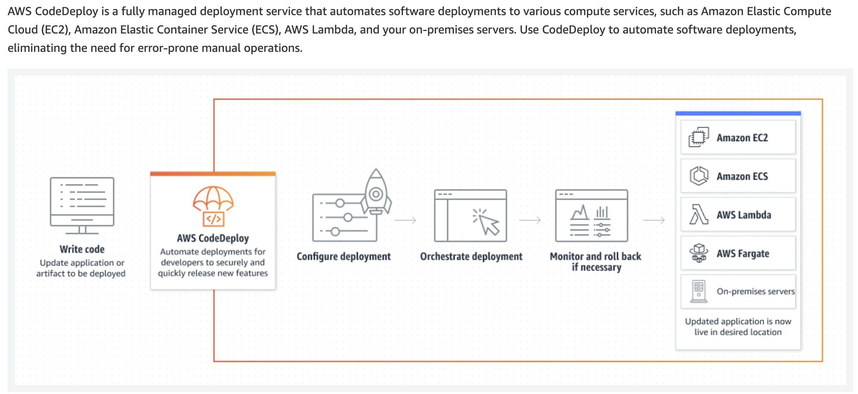
Amazon Code Deploy

Slide 10
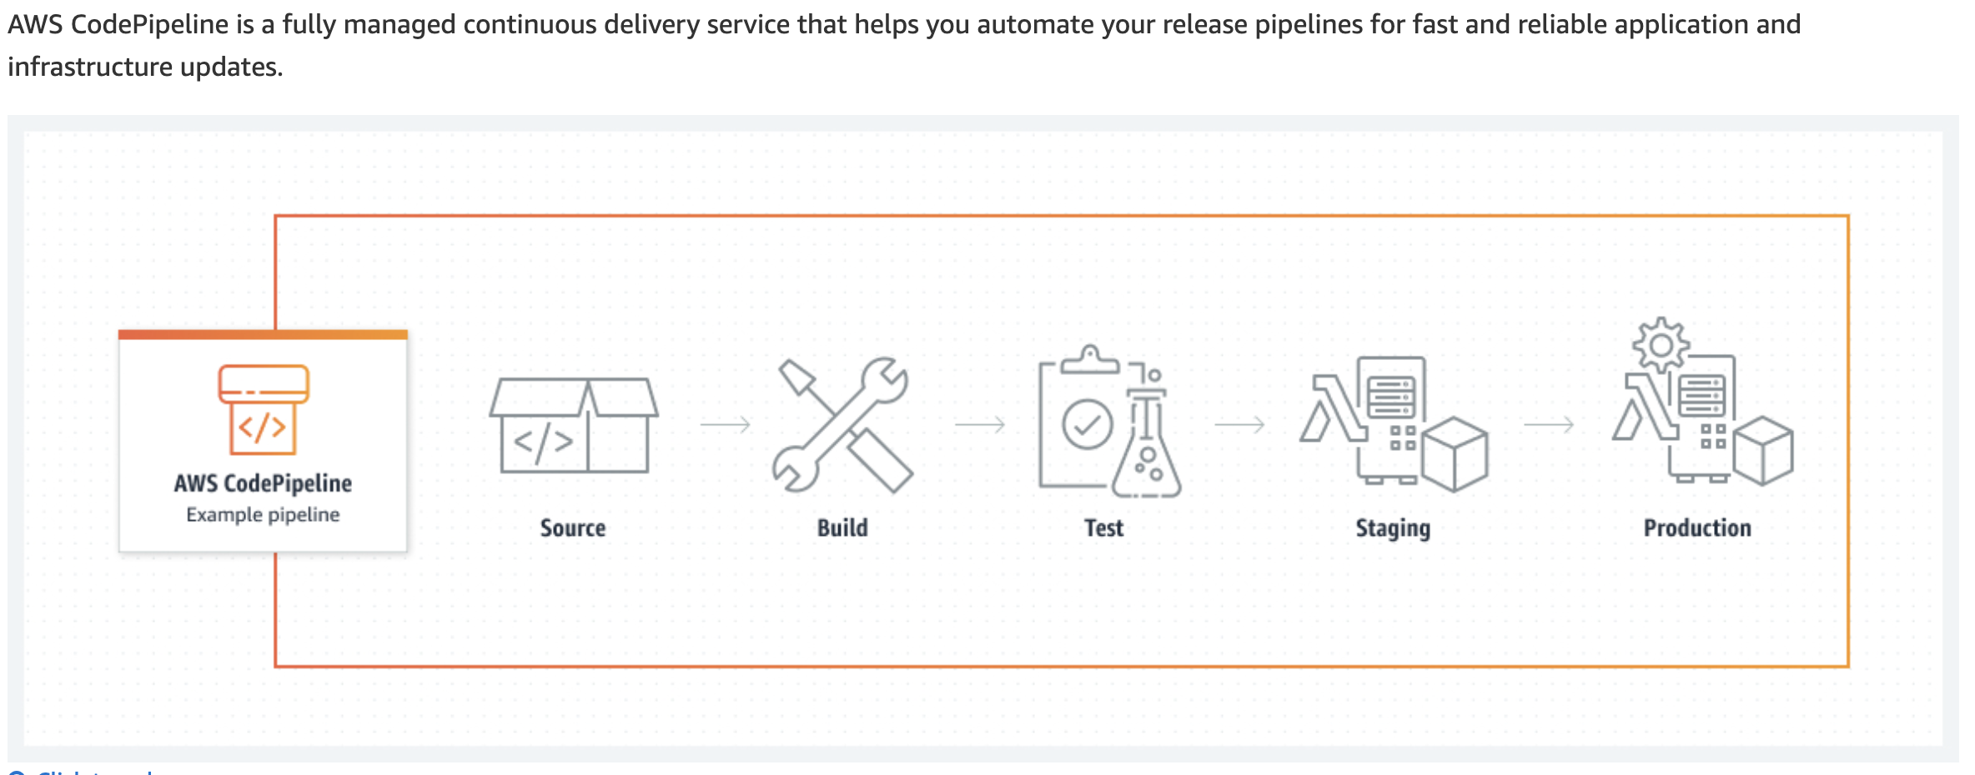
CodePipeline

Slide 11
Cloudwatch Events
Amazon CloudWatch Events delivers a near real-time stream of system events that describe changes in Amazon Web Services (AWS) resources. Using simple rules that you can quickly set up, you can match events and route them to one or more target functions or streams. CloudWatch Events becomes aware of operational changes as they occur. CloudWatch Events responds to these operational changes and takes corrective action as necessary, by sending messages to respond to the environment, activating functions, making changes, and capturing state information.
https://docs.aws.amazon.com/AmazonCloudWatch/latest/events/WhatIsCloudWatchEvents.html

Slide 12
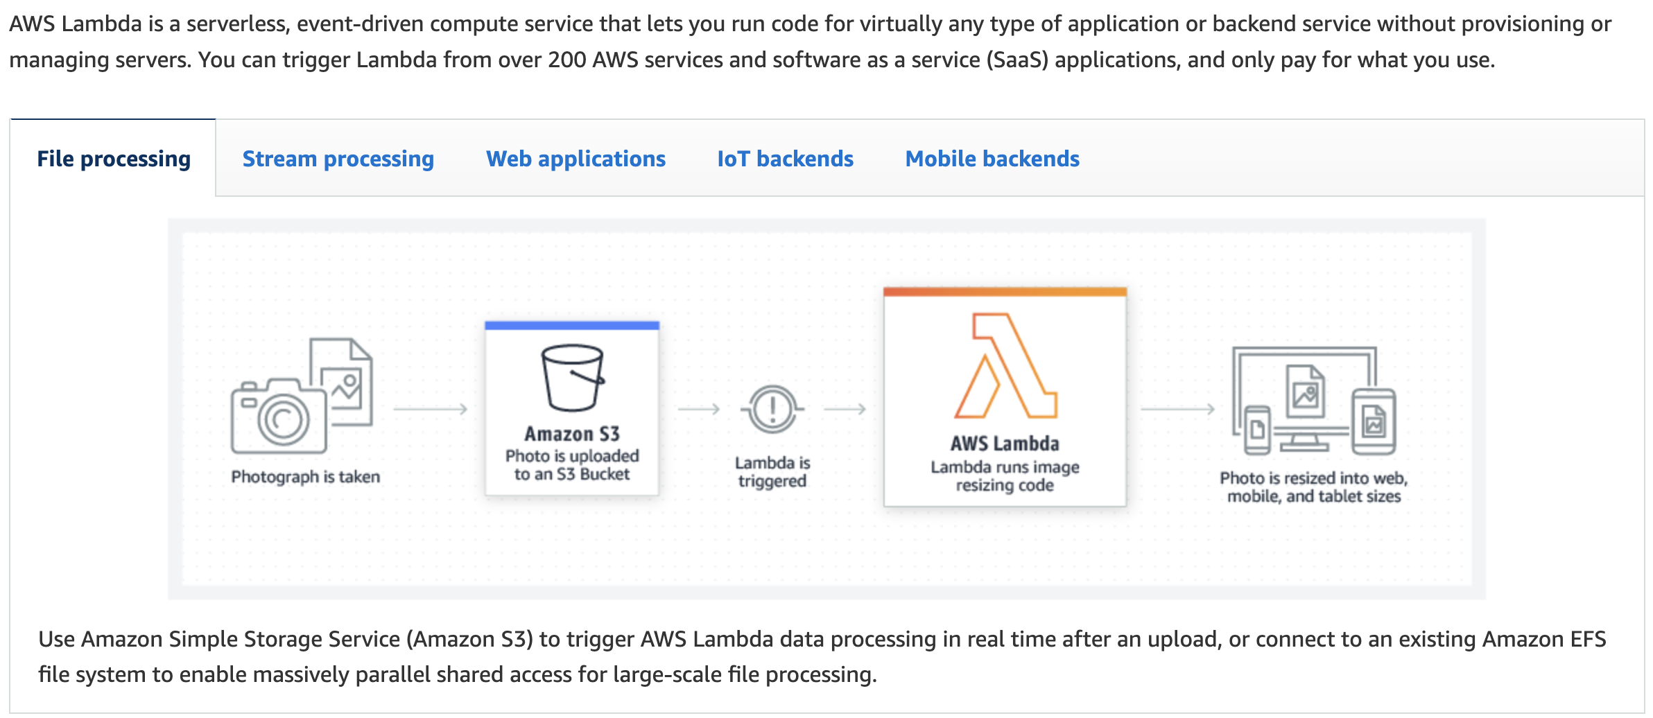
AWS Lambda

Slide 13
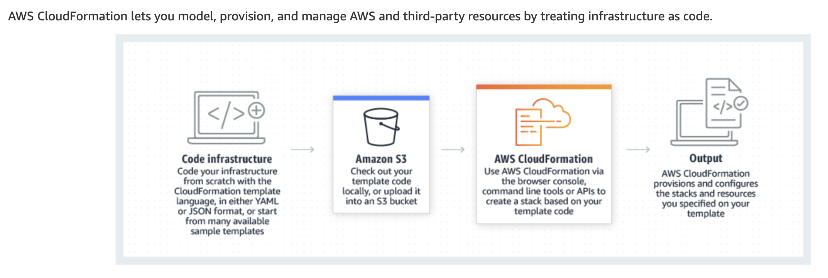
AWS Cloud Formation

Slide 14
Walkthrough
CI/CD Pipeline

Slide 15
A construction technology company provides a Software as a Service (SaaS) solution to engineering firms throughout the United States to use the company’s proprietary system to integrate their engineering documentation and workflows. The DevOps team at the company would like to enable a CICD pipeline that enables safe deployments to production and the ability to work on new features of the product roadmap.
Which solution would you recommend for the given use-case?
Create a CodeCommit repository and set the CICD pipeline to deploy the main branch. For each new feature being implemented, create a new branch and create pull requests to merge into main. Set a repository access policy on your repository to prevent direct pushes to main.
Create a CodeCommit repository and create a branch for each feature. Create a CICD pipeline for each branch, and the last step of the CICD pipeline should be to merge into main. Set an IAM policy on your developer group to prevent direct pushes to main
Create the main CodeCommit repository and set the CICD pipeline to deploy the main branch. For each new feature being implemented, create a new CodeCommit repository and create pull requests to merge into the main repository. Set an IAM policy on your developer group to prevent direct pushes to the main repository
Create a CodeCommit repository and set the CICD pipeline to deploy the main branch. For each new feature being implemented, create a new branch and create pull requests to merge into main. Set an IAM policy on your developer group to prevent direct pushes to main

Slide 16
A construction technology company provides a Software as a Service (SaaS) solution to engineering firms throughout the United States to use the company’s proprietary system to integrate their engineering documentation and workflows. The DevOps team at the company would like to enable a CICD pipeline that enables safe deployments to production and the ability to work on new features of the product roadmap.
Which solution would you recommend for the given use-case?
Create a CodeCommit repository and set the CICD pipeline to deploy the main branch. For each new feature being implemented, create a new branch and create pull requests to merge into main. Set a repository access policy on your repository to prevent direct pushes to main.
Create a CodeCommit repository and create a branch for each feature. Create a CICD pipeline for each branch, and the last step of the CICD pipeline should be to merge into main. Set an IAM policy on your developer group to prevent direct pushes to main
Create the main CodeCommit repository and set the CICD pipeline to deploy the main branch. For each new feature being implemented, create a new CodeCommit repository and create pull requests to merge into the main repository. Set an IAM policy on your developer group to prevent direct pushes to the main repository
Create a CodeCommit repository and set the CICD pipeline to deploy the main branch. For each new feature being implemented, create a new branch and create pull requests to merge into main. Set an IAM policy on your developer group to prevent direct pushes to main

Slide 17
Your company has adopted CodeCommit and forces developers to create new branches and create pull requests before merging the code to main. The development lead reviewing the pull requests needs confidence in the code quality and would like the CICD system to automatically build a Pull Request to provide a testing badge with a pass/fail status.
How can you implement the validation of Pull Requests by CodeBuild efficiently?
Create a CloudWatch Event Rule that reacts to the creation and updates done to Pull Requests in the source repository. The target of that rule should be AWS Lambda. This function invokes CodeBuild and waits for CodeBuild to be done and then updates the Pull Request with a message with the build outcome
Create a CloudWatch Event Rule with a scheduled rate of 5 minutes that invokes a Lambda function. This function checks for the creation and updates done to Pull Requests in the source repository, and invokes CodeBuild when needed. The function waits for CodeBuild to be done and then updates the Pull Request with a message with the build outcome
Create a CloudWatch Event Rule with a scheduled rate of 5 minutes that invokes a Lambda function. This function checks for the creation and updates done to Pull Requests in the source repository, and invokes CodeBuild when needed. Create a CloudWatch Event rule to watch for CodeBuild build success or failure event and as a target invoke a Lambda function that will update the pull request with the Build outcome
Create a CloudWatch Event Rule that reacts to the creation and updates done to Pull Requests in the source repository. The target of that rule should be CodeBuild. Create a second CloudWatch Event rule to watch for CodeBuild build success or failure event and as a target invoke a Lambda function that will update the pull request with the Build outcome

Slide 18
The DevOps team at your company is using CodeDeploy to deploy new versions of a Lambda function after it has passed a CodeBuild check via your CodePipeline. Before deploying, the CodePipeline has a step in which it optionally kickstarts a restructuring of files on an S3 bucket that is forward compatible. That restructuring is done using a Step Function execution which invokes a Fargate task. The new Lambda function cannot work until the restructuring task has fully completed.
As a DevOps Engineer, how can you ensure traffic isn't served to your new Lambda function until the task is completed?
In your appspec.yml file, include an AfterAllowTraffic hook that checks on the completion of the Step Function execution
Include an extra step in the Step Function to signal to CodeDeploy the completion of the restructuring and serve new traffic to the new Lambda function
In your appspec.yml file, include a BeforeAllowTraffic hook that checks on the completion of the Step Function execution
Enable Canary Deployment in CodeDeploy so that only a fraction of the service is served by the new Lambda function while the restructuring is happening

Slide 19
The DevOps team at your company is using CodeDeploy to deploy new versions of a Lambda function after it has passed a CodeBuild check via your CodePipeline. Before deploying, the CodePipeline has a step in which it optionally kickstarts a restructuring of files on an S3 bucket that is forward compatible. That restructuring is done using a Step Function execution which invokes a Fargate task. The new Lambda function cannot work until the restructuring task has fully completed.
As a DevOps Engineer, how can you ensure traffic isn't served to your new Lambda function until the task is completed?
In your appspec.yml file, include an AfterAllowTraffic hook that checks on the completion of the Step Function execution
Include an extra step in the Step Function to signal to CodeDeploy the completion of the restructuring and serve new traffic to the new Lambda function
In your appspec.yml file, include a BeforeAllowTraffic hook that checks on the completion of the Step Function execution
Enable Canary Deployment in CodeDeploy so that only a fraction of the service is served by the new Lambda function while the restructuring is happening

Slide 20
The DevOps team at an e-commerce company is working with the in-house security team to improve the security workflow of the code release process. The DevOps team would like to initiate a 3rd party code vulnerability analysis tool for every push done to code in your CodeCommit repository. The code has to be sent via an external API.
How would you implement this most efficiently?
Create a CloudWatch Event rule on a schedule of 5 minutes that triggers a Lambda function that will check for new commits done on your CodeCommit repository. If new commits are detected, download and zip the code and then send it to the 3rd party API
Create a CloudWatch Event rule on your CodeCommit repository that reacts to pushes. As a target, choose an S3 bucket so that the code will be automatically zipped into S3. Create an S3 Event rule to trigger a Lambda function that will retrieve the zipped code from S3 and send it to the 3rd party API
Create a CodeCommit hook on an EC2 instance that streams changes from CodeCommit into the local filesystem. A cron job on the EC2 instance will zip the code and send it to the 3rd party API upon changes being detected
Create a CloudWatch Event rule on your CodeCommit repository that reacts to pushes. As a target, choose an AWS Lambda function that will request the code from CodeCommit, zip it and send it to the 3rd party API

Slide 21
The DevOps team at an e-commerce company is working with the in-house security team to improve the security workflow of the code release process. The DevOps team would like to initiate a 3rd party code vulnerability analysis tool for every push done to code in your CodeCommit repository. The code has to be sent via an external API.
How would you implement this most efficiently?
Create a CloudWatch Event rule on a schedule of 5 minutes that triggers a Lambda function that will check for new commits done on your CodeCommit repository. If new commits are detected, download and zip the code and then send it to the 3rd party API
Create a CloudWatch Event rule on your CodeCommit repository that reacts to pushes. As a target, choose an S3 bucket so that the code will be automatically zipped into S3. Create an S3 Event rule to trigger a Lambda function that will retrieve the zipped code from S3 and send it to the 3rd party API
Create a CodeCommit hook on an EC2 instance that streams changes from CodeCommit into the local filesystem. A cron job on the EC2 instance will zip the code and send it to the 3rd party API upon changes being detected
Create a CloudWatch Event rule on your CodeCommit repository that reacts to pushes. As a target, choose an AWS Lambda function that will request the code from CodeCommit, zip it and send it to the 3rd party API

Slide 22
The DevOps team at a business travel solutions company wants to use CodeDeploy to ensure zero downtime during deployments through rolling updates. The team wants to deploy the company's web application on a set of 5 EC2 instances running behind an Application Load Balancer. The team would like the deployment to be gradual and to automatically rollback in case of a failed deployment, which is determined by the application not being able to pass health checks.
Which of the following options would you recommend for the given use-case?
In the ValidateService hook in appspec.yml, verify the service is properly running. Configure CodeDeploy to rollback on deployment failures. In case the hook fails, then CodeDeploy will rollback
In the AfterInstall hook in appspec.yml, verify the service is properly running. Configure CodeDeploy to rollback on deployment failures. In case the hook fails, then CodeDeploy will rollback
Integrate CodeDeploy with the Application Load Balancer. In case the Application Load Balancers fails the health checks on the instances where the new version has been deployed, it will notify CodeDeploy. Configure CodeDeploy to rollback on deployment failures
Create a CloudWatch Event rule on CodeDeploy to invoke a Lambda function upon deployment on every instance. The Lambda function tests the health check, and if it fails, stops the CodeDeploy deployment using the StopDeployment API, and then start a new deployment of the old version using the CreateDeployment API

Slide 23
The DevOps team at a business travel solutions company wants to use CodeDeploy to ensure zero downtime during deployments through rolling updates. The team wants to deploy the company's web application on a set of 5 EC2 instances running behind an Application Load Balancer. The team would like the deployment to be gradual and to automatically rollback in case of a failed deployment, which is determined by the application not being able to pass health checks.
Which of the following options would you recommend for the given use-case?
In the ValidateService hook in appspec.yml, verify the service is properly running. Configure CodeDeploy to rollback on deployment failures. In case the hook fails, then CodeDeploy will rollback
In the AfterInstall hook in appspec.yml, verify the service is properly running. Configure CodeDeploy to rollback on deployment failures. In case the hook fails, then CodeDeploy will rollback
Integrate CodeDeploy with the Application Load Balancer. In case the Application Load Balancers fails the health checks on the instances where the new version has been deployed, it will notify CodeDeploy. Configure CodeDeploy to rollback on deployment failures
Create a CloudWatch Event rule on CodeDeploy to invoke a Lambda function upon deployment on every instance. The Lambda function tests the health check, and if it fails, stops the CodeDeploy deployment using the StopDeployment API, and then start a new deployment of the old version using the CreateDeployment API

Slide 24
As part of the CICD pipeline, the DevOps team at a retail company wants to deploy the latest application code to a staging environment and the team also wants to ensure it can execute an automated functional test suite before deploying to production. The code is managed via CodeCommit. Usually, the functional test suite runs for over two hours. The company has hired you as an AWS Certified DevOps Engineer Professional to build a solution for this requirement.
How would you create the CICD pipeline to run your test suite in the most efficient way?
Create a CodePipeline pointing to the main branch of your CodeCommit repository and as a first stage run a CodeBuild build that will run the test suite against the staging environment. Upon passing, deploy to staging using CodeDeploy and if it succeeds, deploy to production
Create a CodePipeline pointing to the main branch of your CodeCommit repository and automatically deploy to a staging environment using CodeDeploy. After that stage, invoke a custom stage using a Lambda function that will run the test suite. If the stage doesn't fail, the last stage will deploy the application to production
Create a CodePipeline pointing to the main branch of your CodeCommit repository and automatically deploy to a staging environment using CodeDeploy. After that stage, invoke a custom stage using a Lambda function that will invoke a Step Function execution. The Step Function will run the test suite. Create a CloudWatch Event Rule on the execution termination of your Step Function to invoke a Lambda function and signal CodePipeline the success or failure. If the stage doesn't fail, the last stage will deploy the application to production
Create a CodePipeline pointing to the main branch of your CodeCommit repository and automatically deploy to a staging environment using CodeDeploy. After that stage, invoke a CodeBuild build that will run the test suite. If the stage doesn't fail, the last stage will deploy the application to production

Slide 25
As part of the CICD pipeline, the DevOps team at a retail company wants to deploy the latest application code to a staging environment and the team also wants to ensure it can execute an automated functional test suite before deploying to production. The code is managed via CodeCommit. Usually, the functional test suite runs for over two hours. The company has hired you as an AWS Certified DevOps Engineer Professional to build a solution for this requirement.
How would you create the CICD pipeline to run your test suite in the most efficient way?
Create a CodePipeline pointing to the main branch of your CodeCommit repository and as a first stage run a CodeBuild build that will run the test suite against the staging environment. Upon passing, deploy to staging using CodeDeploy and if it succeeds, deploy to production
Create a CodePipeline pointing to the main branch of your CodeCommit repository and automatically deploy to a staging environment using CodeDeploy. After that stage, invoke a custom stage using a Lambda function that will run the test suite. If the stage doesn't fail, the last stage will deploy the application to production
Create a CodePipeline pointing to the main branch of your CodeCommit repository and automatically deploy to a staging environment using CodeDeploy. After that stage, invoke a custom stage using a Lambda function that will invoke a Step Function execution. The Step Function will run the test suite. Create a CloudWatch Event Rule on the execution termination of your Step Function to invoke a Lambda function and signal CodePipeline the success or failure. If the stage doesn't fail, the last stage will deploy the application to production
Create a CodePipeline pointing to the main branch of your CodeCommit repository and automatically deploy to a staging environment using CodeDeploy. After that stage, invoke a CodeBuild build that will run the test suite. If the stage doesn't fail, the last stage will deploy the application to production

Slide 26
The DevOps team at a leading bitcoin wallet and exchange services company is trying to deploy a CloudFormation template that contains a Lambda Function, an S3 bucket, an IAM role, and a DynamoDB table from CodePipeline but the team is getting an InsufficientCapabilitiesException.
Which of the following options would you suggest fixing this issue?
Update the CodePipeline IAM Role so it has permissions to create all the resources mentioned in the CloudFormation template
Enable the IAM Capability on the CodePipeline configuration for the Deploy CloudFormation stage action
Fix the CloudFormation template as there is circular dependency and CloudFormation does not have that capability
Increase the service limits for your S3 bucket limits as you've reached it

Slide 27
The DevOps team at a leading bitcoin wallet and exchange services company is trying to deploy a CloudFormation template that contains a Lambda Function, an S3 bucket, an IAM role, and a DynamoDB table from CodePipeline but the team is getting an InsufficientCapabilitiesException.
Which of the following options would you suggest fixing this issue?
Update the CodePipeline IAM Role so it has permissions to create all the resources mentioned in the CloudFormation template
Enable the IAM Capability on the CodePipeline configuration for the Deploy CloudFormation stage action
Fix the CloudFormation template as there is circular dependency and CloudFormation does not have that capability
Increase the service limits for your S3 bucket limits as you've reached it

Slide 28
Configuration Management and IaC

Slide 29
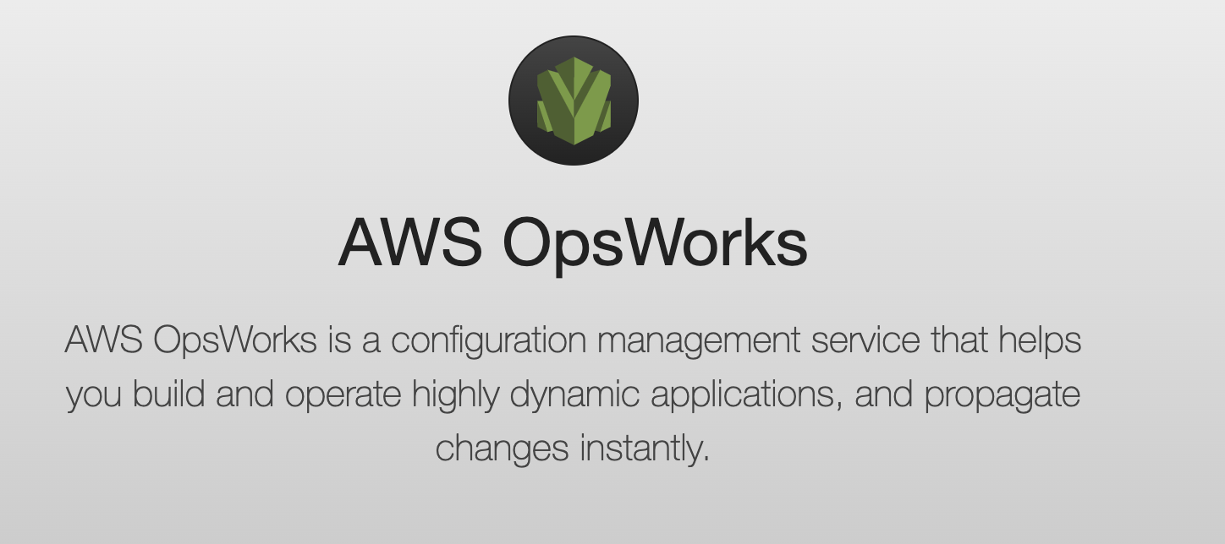
AWS OpsWorks

Slide 30
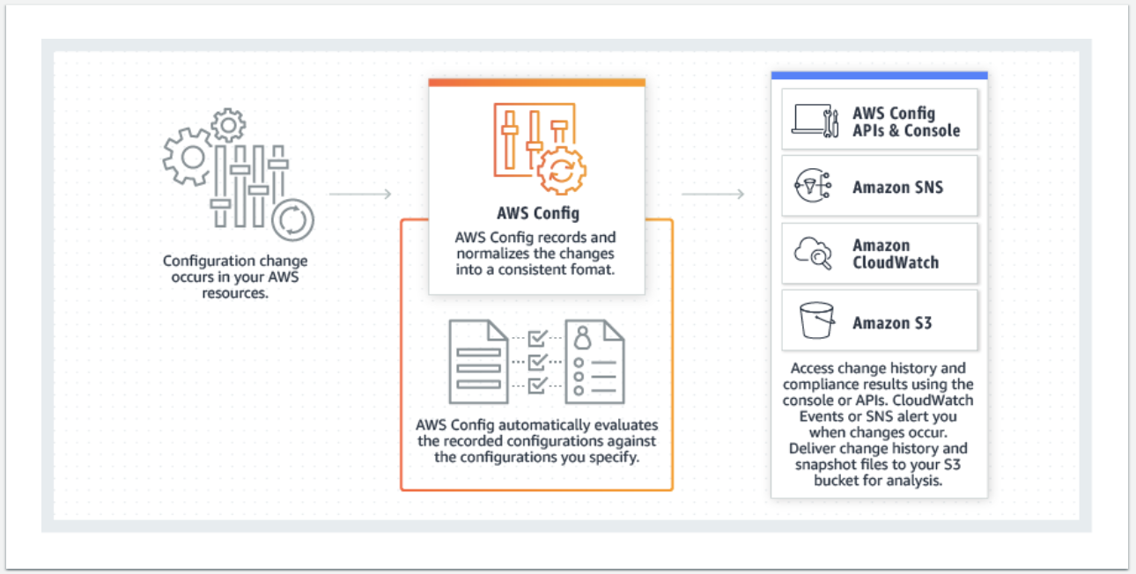
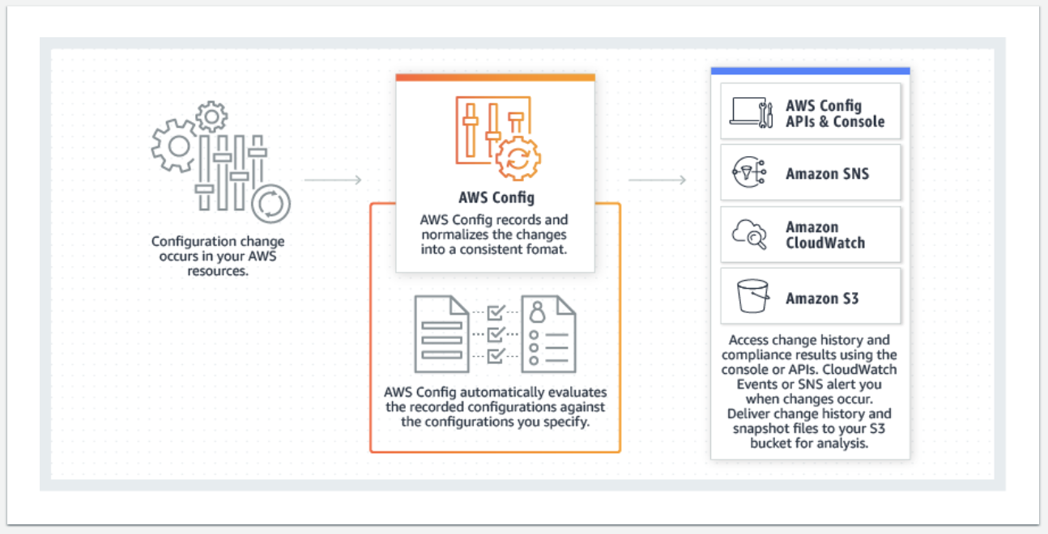
AWS Config
AWS Config provides a detailed view of the resources associated with your AWS account, including how they are configured, how they are related to one another, and how the configurations and their relationships have changed over time.

Slide 31
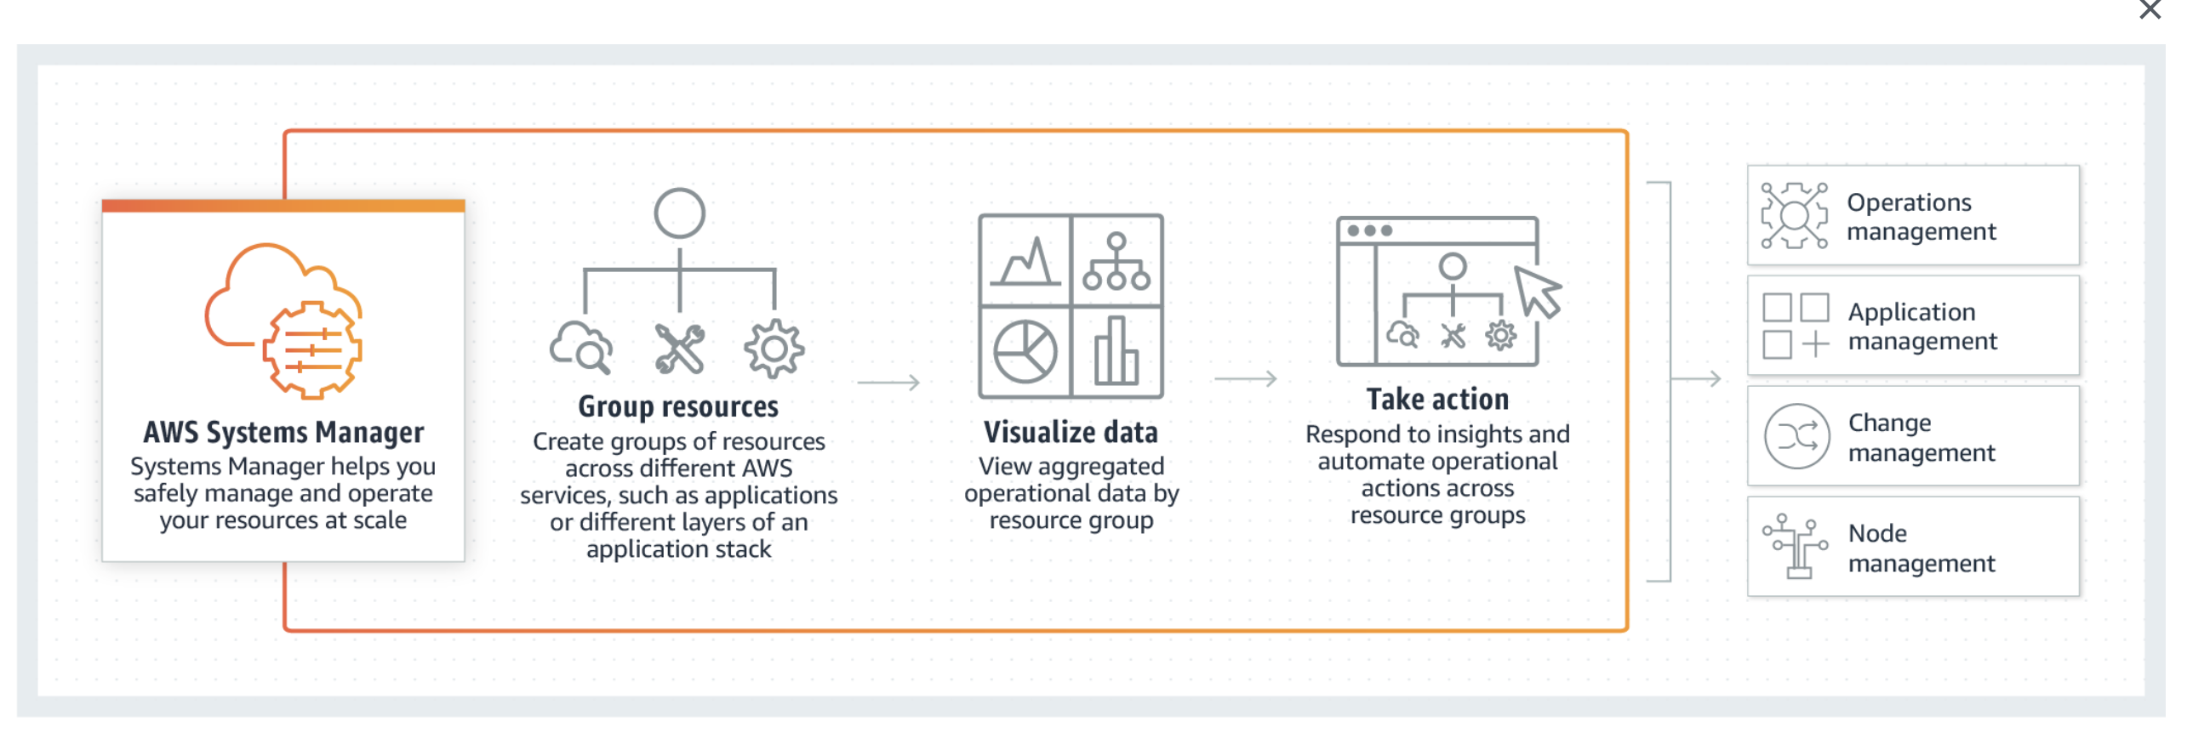
AWS Systems Manager
AWS Systems Manager is a secure end-to-end management solution for hybrid cloud environments.

Slide 32
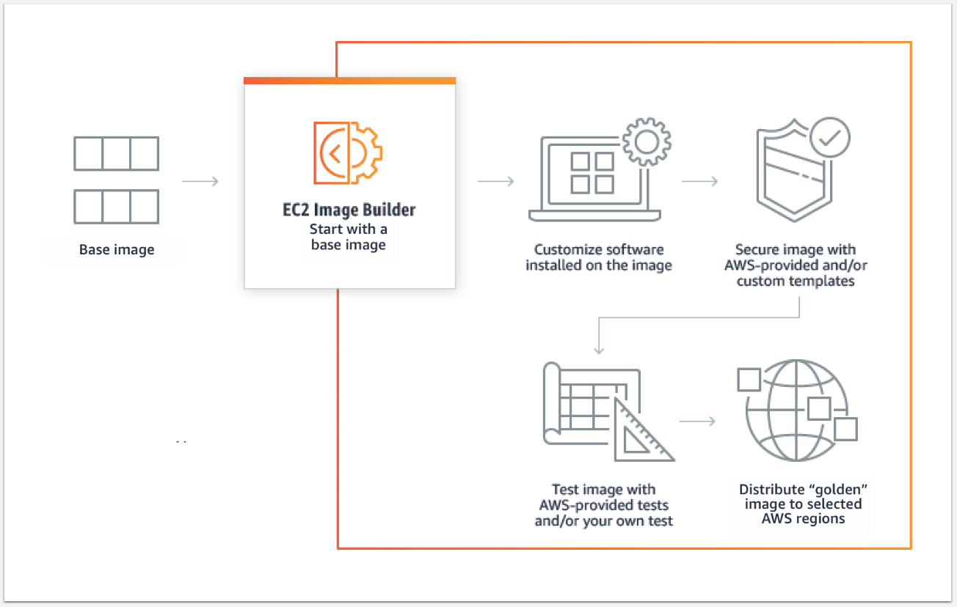
EC2 Image Builder
EC2 Image Builder is a fully-managed service that makes it easy to build, customize and deploy OS images without writing scripts.

Slide 33
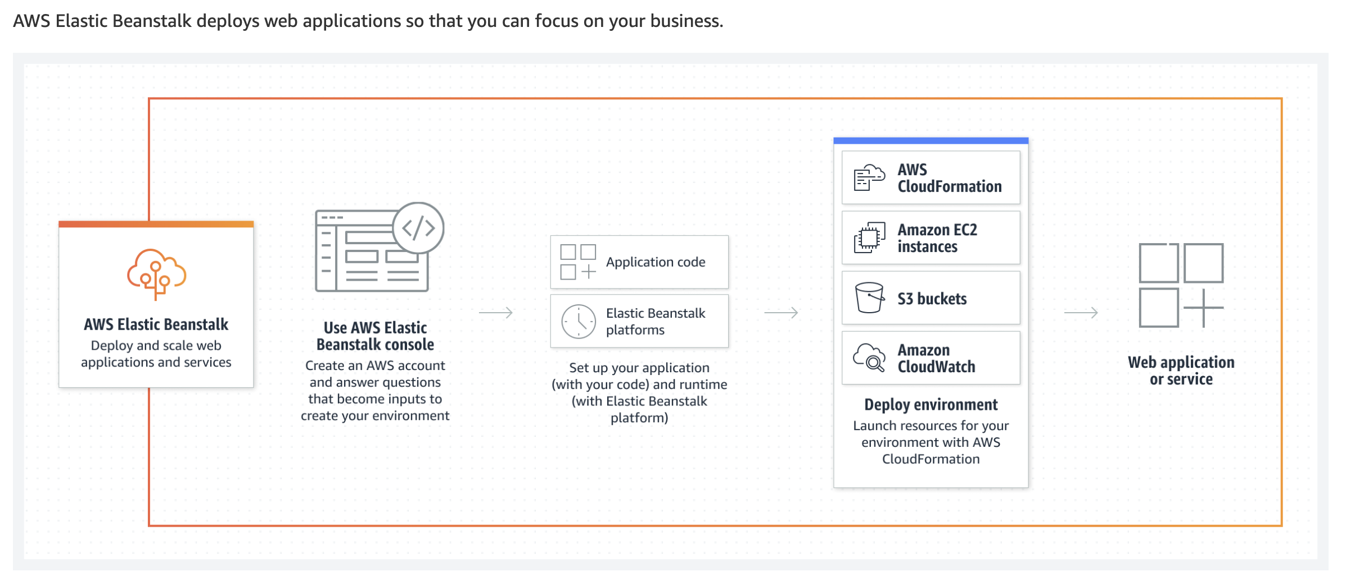
AWS Elastic Beanstalk

Slide 34
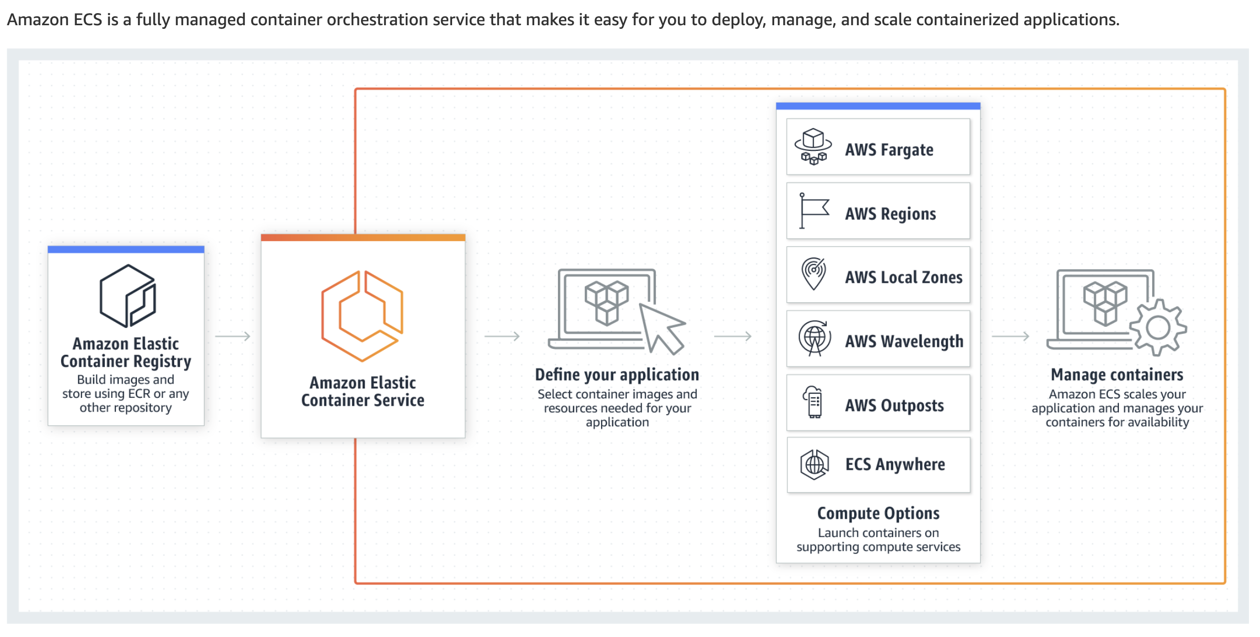
ECS

Slide 35
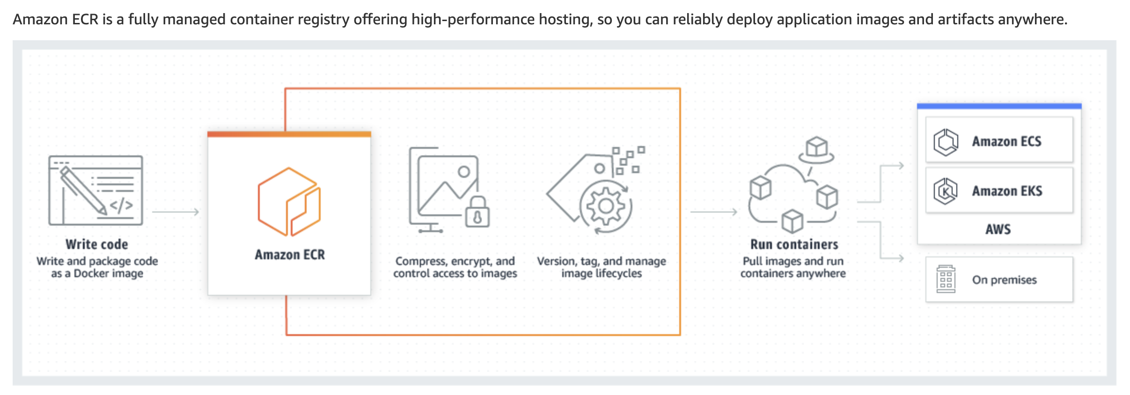
ECR

Slide 36
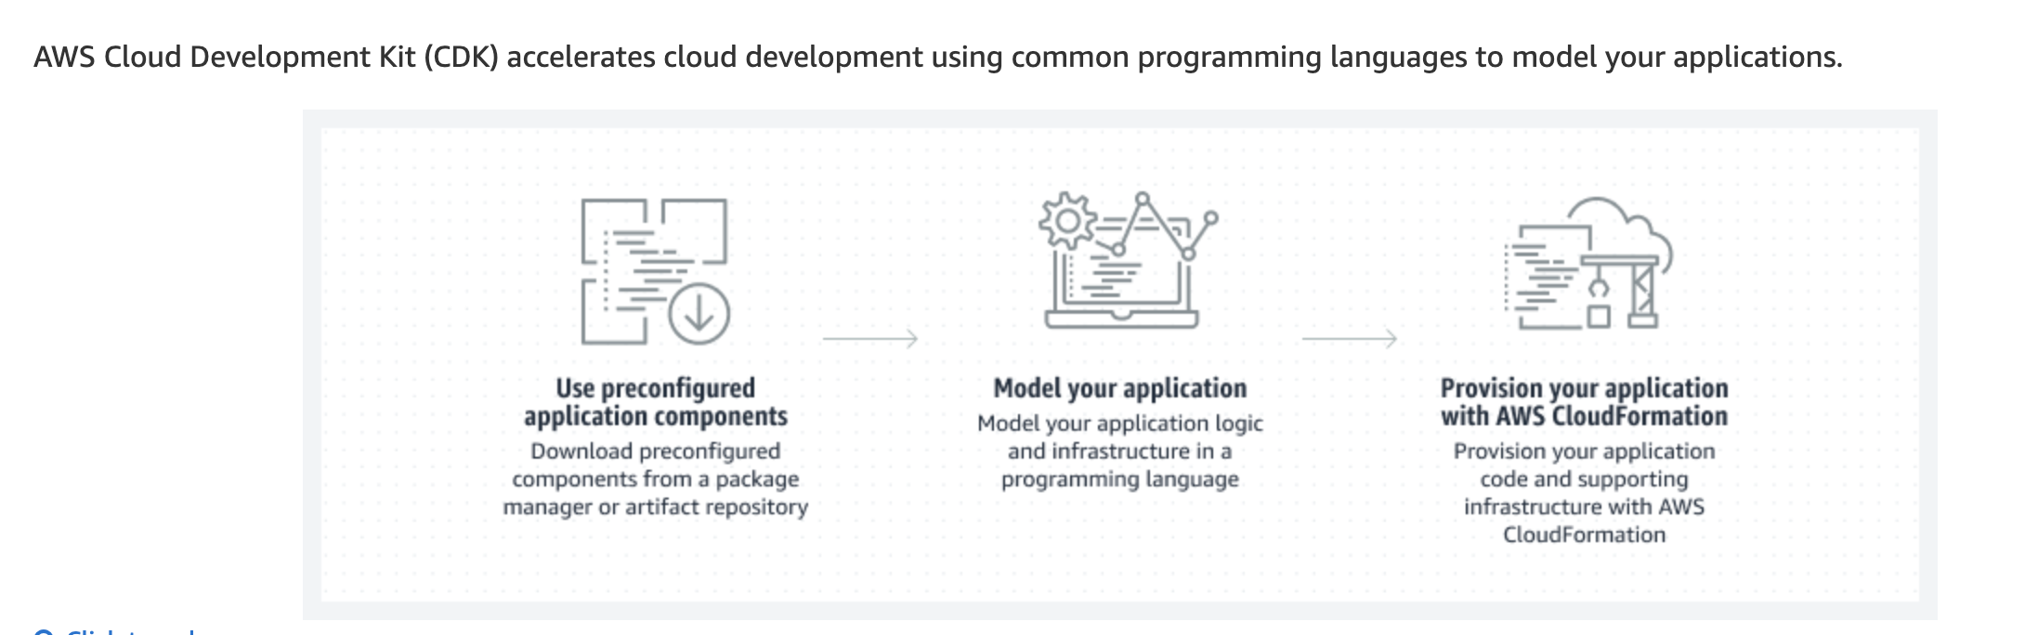
AWS CDK

Slide 37
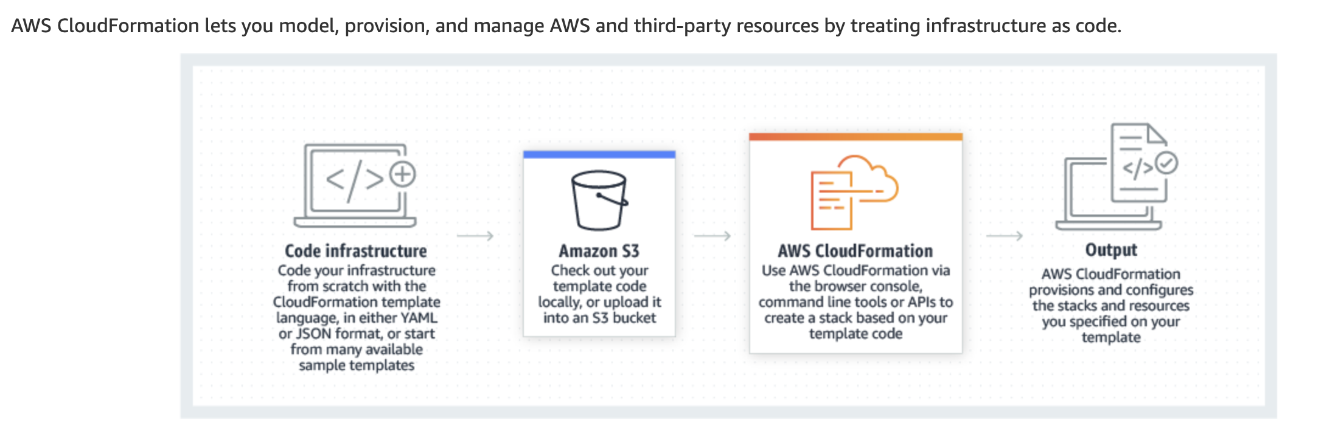
Cloud Formation

Slide 38
Demo: ECS, ECR, CDK and Cloud Formation

Slide 39
Your application is deployed on Elastic Beanstalk and you manage the configuration of the stack using a CloudFormation template. A new golden AMI is created every week and contains a hardened AMI that has all the necessary recent security patches. You have deployed over 100 applications using CloudFormation & Beanstalk this way and you would like to ensure the newer AMI used for EC2 instances is updated every week. There are no standardization or naming conventions made across all the CloudFormation templates.
As a DevOps Engineer, how would you implement a solution for this requirement?
Store the Golden AMI id in an S3 object. Create a CloudFormation mapping to contain the last value of the Golden AMI id. That mapping is passed on to the configuration of the Elastic Beanstalk environment. Create a CloudWatch Event rule that is triggered every week that will launch a Lambda function. That Lambda function should update the mapping section of every CloudFormation template using a YAML parser, upload the new templates to S3 and trigger a refresh of all the CloudFormation templates using the UpdateStack API while passing the new parameter
Store the Golden AMI id in an S3 object. Create a CloudFormation parameter that points to the S3 object, and is passed on to the configuration of the Elastic Beanstalk environment. Create a CloudWatch Event rule that is triggered every week that will launch a Lambda function. That Lambda function should trigger a refresh of all the CloudFormation templates using the UpdateStack API
Store the Golden AMI id in an SSM Parameter Store parameter. Create a CloudFormation parameter of type String, and is passed on to the configuration of the Elastic Beanstalk environment. Create a CloudWatch Event rule that is triggered every week that will launch a Lambda function. That Lambda function should fetch the parameter from the SSM Parameter Store and trigger a refresh of all the CloudFormation templates using the UpdateStack API while passing the new parameter
Store the Golden AMI id in an SSM Parameter Store parameter. Create a CloudFormation parameter that points to the SSM Parameter Store, and is passed on to the configuration of the Elastic Beanstalk environment. Create a CloudWatch Event rule that is triggered every week that will launch a Lambda function. That Lambda function should trigger a refresh of all the CloudFormation templates using the UpdateStack API

Slide 40
Your application is deployed on Elastic Beanstalk and you manage the configuration of the stack using a CloudFormation template. A new golden AMI is created every week and contains a hardened AMI that has all the necessary recent security patches. You have deployed over 100 applications using CloudFormation & Beanstalk this way and you would like to ensure the newer AMI used for EC2 instances is updated every week. There are no standardization or naming conventions made across all the CloudFormation templates.
As a DevOps Engineer, how would you implement a solution for this requirement?
Store the Golden AMI id in an S3 object. Create a CloudFormation mapping to contain the last value of the Golden AMI id. That mapping is passed on to the configuration of the Elastic Beanstalk environment. Create a CloudWatch Event rule that is triggered every week that will launch a Lambda function. That Lambda function should update the mapping section of every CloudFormation template using a YAML parser, upload the new templates to S3 and trigger a refresh of all the CloudFormation templates using the UpdateStack API while passing the new parameter
Store the Golden AMI id in an S3 object. Create a CloudFormation parameter that points to the S3 object, and is passed on to the configuration of the Elastic Beanstalk environment. Create a CloudWatch Event rule that is triggered every week that will launch a Lambda function. That Lambda function should trigger a refresh of all the CloudFormation templates using the UpdateStack API
Store the Golden AMI id in an SSM Parameter Store parameter. Create a CloudFormation parameter of type String, and is passed on to the configuration of the Elastic Beanstalk environment. Create a CloudWatch Event rule that is triggered every week that will launch a Lambda function. That Lambda function should fetch the parameter from the SSM Parameter Store and trigger a refresh of all the CloudFormation templates using the UpdateStack API while passing the new parameter
Store the Golden AMI id in an SSM Parameter Store parameter. Create a CloudFormation parameter that points to the SSM Parameter Store, and is passed on to the configuration of the Elastic Beanstalk environment. Create a CloudWatch Event rule that is triggered every week that will launch a Lambda function. That Lambda function should trigger a refresh of all the CloudFormation templates using the UpdateStack API

Slide 41
The DevOps team at a presentation software company is deploying their flagship application using Elastic Beanstalk. The application is deployed using a Deploy stage in a CodePipeline pipeline. The technical requirements mandate changing the configuration of the Application Load Balancer tied to Elastic Beanstalk by adding an HTTP to HTTPS redirection rule.
As a DevOps Engineer, you don't have the permissions to directly edit the Elastic Beanstalk environment, how can you proceed?
Create a file named .ebextensions/alb.config in your code repository and add a container_commands block for which you will specify a container command that will run in leader_only mode. The EC2 instance will issue an API call to the Load Balancer to add the redirection rule
Using the EB CLI, create a .elasticbeanstalk/saved_configs/config.yml, and specify the rules for the key aws:elbv2:listener:default. Configure CodePipeline to deploy to Elastic Beanstalk using the EB CLI and push the code
Create a file named .ebextensions/alb.config in your code repository and add an option_settings block for which you will specify the Rules for the key aws:elbv2:listener:default. Push your code and let the CodePipeline run
Using the EB CLI, create a .elasticbeanstalk/saved_configs/config.yml, and specify the rules for the key aws:elbv2:listener:default. Run a deploy using the EB CLI from your computer onto the Elastic Beanstalk Environment

Slide 42
The DevOps team at a presentation software company is deploying their flagship application using Elastic Beanstalk. The application is deployed using a Deploy stage in a CodePipeline pipeline. The technical requirements mandate changing the configuration of the Application Load Balancer tied to Elastic Beanstalk by adding an HTTP to HTTPS redirection rule.
As a DevOps Engineer, you don't have the permissions to directly edit the Elastic Beanstalk environment, how can you proceed?
Create a file named .ebextensions/alb.config in your code repository and add a container_commands block for which you will specify a container command that will run in leader_only mode. The EC2 instance will issue an API call to the Load Balancer to add the redirection rule
Using the EB CLI, create a .elasticbeanstalk/saved_configs/config.yml, and specify the rules for the key aws:elbv2:listener:default. Configure CodePipeline to deploy to Elastic Beanstalk using the EB CLI and push the code
Create a file named .ebextensions/alb.config in your code repository and add an option_settings block for which you will specify the Rules for the key aws:elbv2:listener:default. Push your code and let the CodePipeline run
Using the EB CLI, create a .elasticbeanstalk/saved_configs/config.yml, and specify the rules for the key aws:elbv2:listener:default. Run a deploy using the EB CLI from your computer onto the Elastic Beanstalk Environment

Slide 43
A Big Data analytics company is operating a distributed Cassandra cluster on EC2. Each instance in the cluster must have a list of all the other instance's IP to function correctly, store in a configuration file. As a Devops Engineer at the company, you would like this solution to adapt automatically when newer EC2 instances join the cluster, or when some EC2 instances are terminated.
Which of the following solutions would you recommend for the given requirement?
Manage the EC2 instances using an Auto Scaling Group. Include a lifecycle hook for the instance pending and termination that will trigger an AWS Lambda function. The Lambda function will issue an EC2 DescribeInstances API call and update the configuration file through SSH
Manage the EC2 instances using OpsWorks. Include a chef cookbook on the configure lifecycle event that will update the configuration file accordingly
Manage the EC2 instances using an Auto Scaling Group. Include a lifecycle hook for the instance pending and termination that will trigger an EC2 user-data script on the EC2 instances. The script issues an EC2 DescribeInstances API call and update the configuration file locally
Manage the EC2 instances using OpsWorks. Include a chef cookbook on the setup lifecycle event that will update the configuration file accordingly

Slide 44
A Big Data analytics company is operating a distributed Cassandra cluster on EC2. Each instance in the cluster must have a list of all the other instance's IP to function correctly, store in a configuration file. As a Devops Engineer at the company, you would like this solution to adapt automatically when newer EC2 instances join the cluster, or when some EC2 instances are terminated.
Which of the following solutions would you recommend for the given requirement?
Manage the EC2 instances using an Auto Scaling Group. Include a lifecycle hook for the instance pending and termination that will trigger an AWS Lambda function. The Lambda function will issue an EC2 DescribeInstances API call and update the configuration file through SSH
Manage the EC2 instances using OpsWorks. Include a chef cookbook on the configure lifecycle event that will update the configuration file accordingly
Manage the EC2 instances using an Auto Scaling Group. Include a lifecycle hook for the instance pending and termination that will trigger an EC2 user-data script on the EC2 instances. The script issues an EC2 DescribeInstances API call and update the configuration file locally
Manage the EC2 instances using OpsWorks. Include a chef cookbook on the setup lifecycle event that will update the configuration file accordingly

Slide 45
As part of the CICD pipeline, a DevOps Engineer is performing a functional test using a CloudFormation template that will later get deployed to production. That CloudFormation template creates an S3 bucket and a Lambda function which transforms images uploaded into S3 into thumbnails. To test the Lambda function, a few images are automatically uploaded and the thumbnail output is expected from the Lambda function on the S3 bucket. As part of the clean-up of these functional tests, the CloudFormation stack is deleted, but right now the delete fails.
What's the reason and how could this issue be fixed?
The S3 bucket contains files and therefore cannot be deleted by CloudFormation. Create an additional Custom Resource backed by a Lambda function that performs a clean-up of the bucket
The S3 bucket contains files and therefore cannot be deleted by CloudFormation. Add the property Delete: Force to your CloudFormation template so that the S3 bucket is emptied before being deleted
A StackPolicy prevents the CloudFormation template to be deleted. Clear the Stack Policy and try again
The Lambda function is still using the S3 bucket and CloudFormation cannot, therefore, delete the S3 bucket. Place a WaitCondition on the Lambda function to fix the issue

Slide 46
As part of the CICD pipeline, a DevOps Engineer is performing a functional test using a CloudFormation template that will later get deployed to production. That CloudFormation template creates an S3 bucket and a Lambda function which transforms images uploaded into S3 into thumbnails. To test the Lambda function, a few images are automatically uploaded and the thumbnail output is expected from the Lambda function on the S3 bucket. As part of the clean-up of these functional tests, the CloudFormation stack is deleted, but right now the delete fails.
What's the reason and how could this issue be fixed?
The S3 bucket contains files and therefore cannot be deleted by CloudFormation. Create an additional Custom Resource backed by a Lambda function that performs a clean-up of the bucket
The S3 bucket contains files and therefore cannot be deleted by CloudFormation. Add the property Delete: Force to your CloudFormation template so that the S3 bucket is emptied before being deleted
A StackPolicy prevents the CloudFormation template to be deleted. Clear the Stack Policy and try again
The Lambda function is still using the S3 bucket and CloudFormation cannot, therefore, delete the S3 bucket. Place a WaitCondition on the Lambda function to fix the issue

Slide 47
The DevOps team at a leading travel-booking services company is using a CloudFormation template to deploy a Lambda function. The Lambda function code is uploaded into S3 into a file named s3://my-bucket/my-lambda-code.zip by CodePipeline after having passed all the required build checks. CodePipeline then invokes the CloudFormation template to deploy the new code. The team has found that although the CloudFormation template successfully runs, the Lambda function is not updated.
As a DevOps Engineer, what can you do to quickly fix this issue?
(Select three)
Upload the code every time with a new filename in the same bucket
Add a pause of 3 seconds before starting the CloudFormation job. This is an eventual consistency issue due to overwriting PUT
Clear the Lambda cache with a Custom Job in CodePipeline before the CloudFormation step
Enable the SAM Framework option
Upload the code every time to a new S3 bucket
Enable S3 versioning and provide an S3ObjectVersion key

Slide 48
Monitoring and Logging

Slide 49
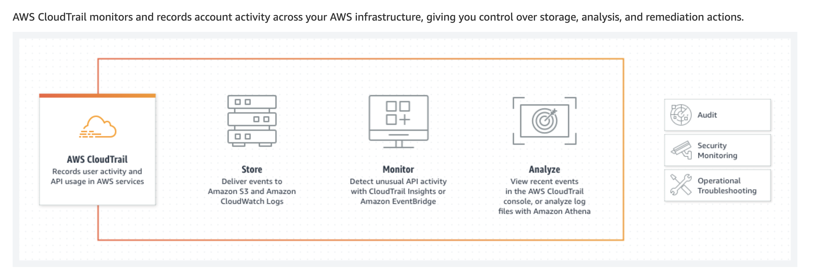
AWS CloudTrail

Slide 50
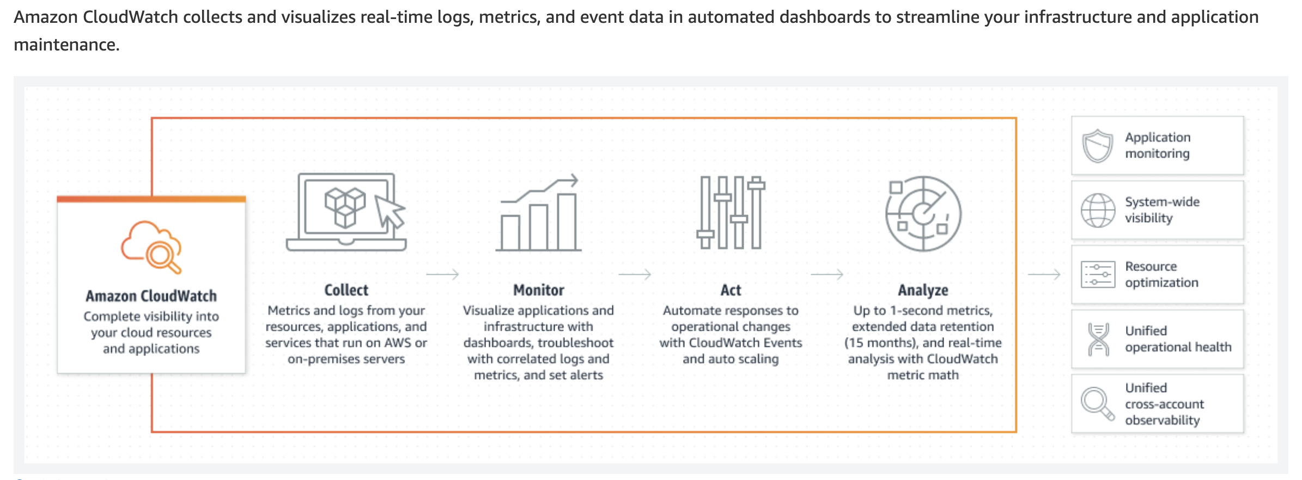
Cloudwatch

Slide 51
Cloudwatch Metrics
Metrics are data about the performance of your systems. By default, many services provide free metrics for resources (such as Amazon EC2 instances, Amazon EBS volumes, and Amazon RDS DB instances). You can also enable detailed monitoring for some resources, such as your Amazon EC2 instances, or publish your own application metrics. Amazon CloudWatch can load all the metrics in your account (both AWS resource metrics and application metrics that you provide) for search, graphing, and alarms.

Slide 52
Cloudwatch Logs
CloudWatch Logs enables you to centralize the logs from all of your systems, applications, and AWS services that you use, in a single, highly scalable service. You can then easily view them, search them for specific error codes or patterns, filter them based on specific fields, or archive them securely for future analysis. CloudWatch Logs enables you to see all of your logs, regardless of their source, as a single and consistent flow of events ordered by time, and you can query them and sort them based on other dimensions, group them by specific fields, create custom computations with a powerful query language, and visualize log data in dashboards.

Slide 53
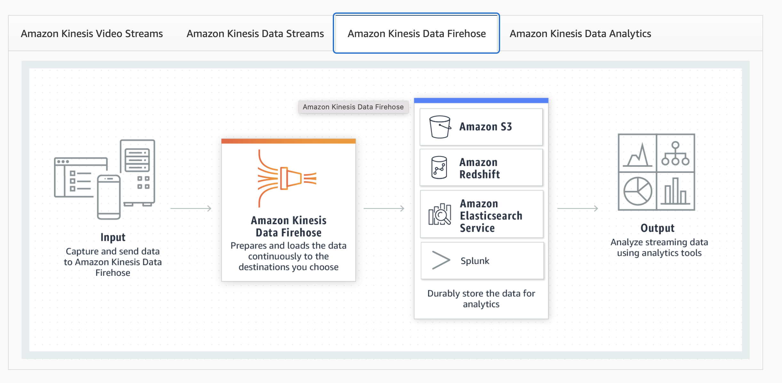
AWS Kinesis Firehose

Slide 54
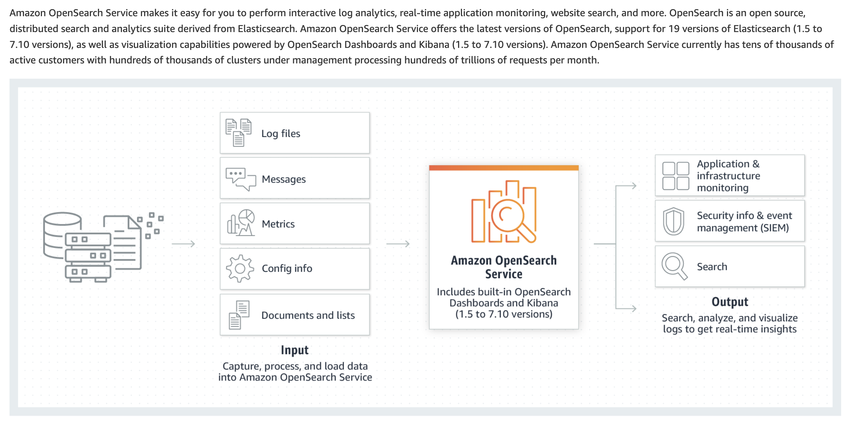
AWS OpenSearch (ELK)

Slide 55
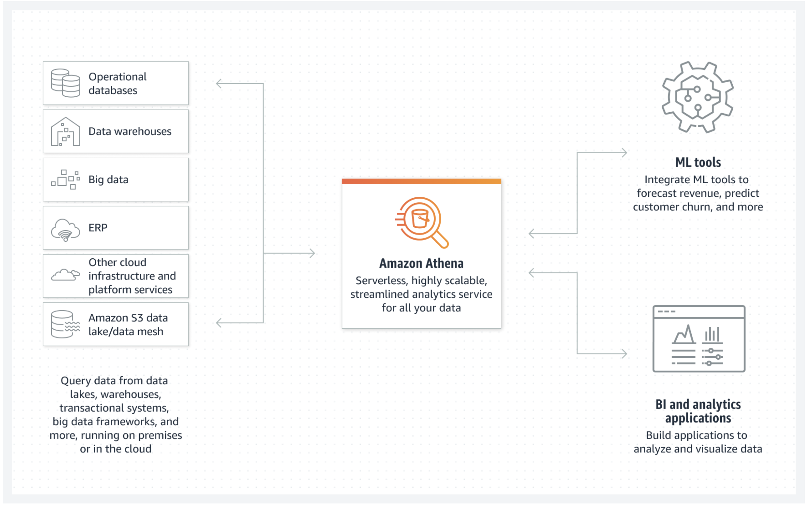
AWS Athena

Slide 56
A financial services company has a solution in place to track all the API calls made by users, applications, and SDK within the AWS account. Recently, it has experienced a hack and could find a user amongst the logs that did some compromising API calls. The company wants to know with 100% certainty that the log files represent the correct sequence of events and have not been altered. The company has hired you as an AWS Certified DevOps Engineer Professional to build a solution for this requirement.
Which of the following would you suggest as the most effective solution?
Turn on API calls logging using AWS CloudTrail. Deliver the logs in an S3 bucket and choose a lifecycle policy that archives file right away in Glacier. Implement a Glacier Vault Lock policy
Turn on API calls logging using AWS CloudTrail. Deliver the logs in an S3 bucket, and use the log verification integrity API call to verify the log file
Turn on AWS account configuration tracking using AWS Config. Deliver the configuration logs into S3 and use the log verification integrity API to verify the log files
Turn on AWS account configuration tracking using AWS Config. Deliver the logs in an S3 bucket and choose a lifecycle policy that archives the files right away in Glacier. Implement a Glacier Vault Lock policy

Slide 57
A financial services company has a solution in place to track all the API calls made by users, applications, and SDK within the AWS account. Recently, it has experienced a hack and could find a user amongst the logs that did some compromising API calls. The company wants to know with 100% certainty that the log files represent the correct sequence of events and have not been altered. The company has hired you as an AWS Certified DevOps Engineer Professional to build a solution for this requirement.
Which of the following would you suggest as the most effective solution?
Turn on API calls logging using AWS CloudTrail. Deliver the logs in an S3 bucket and choose a lifecycle policy that archives file right away in Glacier. Implement a Glacier Vault Lock policy
Turn on API calls logging using AWS CloudTrail. Deliver the logs in an S3 bucket, and use the log verification integrity API call to verify the log file
Turn on AWS account configuration tracking using AWS Config. Deliver the configuration logs into S3 and use the log verification integrity API to verify the log files
Turn on AWS account configuration tracking using AWS Config. Deliver the logs in an S3 bucket and choose a lifecycle policy that archives the files right away in Glacier. Implement a Glacier Vault Lock policy

Slide 58
The compliance department at a Wall Street trading firm has hired you as an AWS Certified DevOps Engineer Professional to help with several strategic DevOps initiatives. The department has asked you to regularly generate the list of all the software packages installed on the EC2 instances. The solution needs to be able to extend to future instances in the AWS account and send notifications if the instances are not set up correctly to track their software.
Which of the following options are the best-fit solutions that require the least effort to meet the given requirements? (Select two)
Install the SSM agent on the instances. Run an SSM Inventory to collect the metadata and send them to Amazon S3
Use an SSM Run Command to have the SSM service find which instances are not currently tracked by SSM
Use AWS Inspector to track the installed package list on your EC2 instances. Visualize the metadata directly in the AWS Inspector Insights console
Install the SSM agent on the instances. Run an SSM Automation during maintenance windows to get the list of all the packages using yum list installed. Write the output to Amazon S3
Create a CloudWatch Event rule to trigger a Lambda function on an hourly basis. Do a comparison of the instances that are running in EC2 and those tracked by SSM

Slide 59
The compliance department at a Wall Street trading firm has hired you as an AWS Certified DevOps Engineer Professional to help with several strategic DevOps initiatives. The department has asked you to regularly generate the list of all the software packages installed on the EC2 instances. The solution needs to be able to extend to future instances in the AWS account and send notifications if the instances are not set up correctly to track their software.
Which of the following options are the best-fit solutions that require the least effort to meet the given requirements? (Select two)
Install the SSM agent on the instances. Run an SSM Inventory to collect the metadata and send them to Amazon S3
Use an SSM Run Command to have the SSM service find which instances are not currently tracked by SSM
Use AWS Inspector to track the installed package list on your EC2 instances. Visualize the metadata directly in the AWS Inspector Insights console
Install the SSM agent on the instances. Run an SSM Automation during maintenance windows to get the list of all the packages using yum list installed. Write the output to Amazon S3
Create a CloudWatch Event rule to trigger a Lambda function on an hourly basis. Do a comparison of the instances that are running in EC2 and those tracked by SSM

Slide 60
A gaming company would like to be able to receive near real-time notifications when the API call DeleteTable is invoked in DynamoDB.
As a DevOps Engineer at the company, how would you implement this at a minimal cost?
Create a CloudTrail event filter and hook it up to a Lambda function. Use the Lambda function to send an SNS notification
Enable CloudTrail. Create a CloudWatch Event rule to track an AWS API call via CloudTrail and use SNS as a target
Enable DynamoDB Streams, and have a Lambda function consuming that stream. Send alerts to SNS whenever a record is being deleted
Send CloudTrail Logs to CloudWatch Logs and use an AWS Lambda function to be triggered on a CloudWatch Logs metrics filter. Use the Lambda function to send an SNS notification

Slide 61
A gaming company would like to be able to receive near real-time notifications when the API call DeleteTable is invoked in DynamoDB.
As a DevOps Engineer at the company, how would you implement this at a minimal cost?
Create a CloudTrail event filter and hook it up to a Lambda function. Use the Lambda function to send an SNS notification
Enable CloudTrail. Create a CloudWatch Event rule to track an AWS API call via CloudTrail and use SNS as a target
Enable DynamoDB Streams, and have a Lambda function consuming that stream. Send alerts to SNS whenever a record is being deleted
Send CloudTrail Logs to CloudWatch Logs and use an AWS Lambda function to be triggered on a CloudWatch Logs metrics filter. Use the Lambda function to send an SNS notification

Slide 62
An analytics company is capturing metrics for its AWS services and applications using CloudWatch metrics. It needs to be able to go back up to 7 years in time for visualizing these metrics due to regulatory requirements. As a DevOps Engineer at the company, you have been tasked with designing a solution that will help the company comply with the regulations.
Which of the following options requires the minimum development effort to address the given requirements?
Create a CloudWatch metrics stream and direct it to Kinesis Firehose Firehose delivery stream. Send all the metrics data into S3 using Firehose, and create a QuickSight dashboard to visualize the metrics. Use Athena to query for specific time ranges
Create a CloudWatch event rule to trigger every 15 minutes. The target of the rule should be a Lambda Function that will run an API call to export the metrics and put them in Amazon ES. Create a Kibana dashboard on top to visualize the metrics
Create a CloudWatch dashboard on top of CloudWatch metrics. Enable 'Extended Retention' on CloudWatch metrics, and implement an AWS Config rule that checks for this setting. If the AWS Config rule is non-compliant, use an Auto Remediation to turn it back on
Create a CloudWatch event rule to trigger every 15 minutes. The target of the rule should be a Lambda Function that will run an API call to export the metrics and put them in S3. Create a CloudWatch dashboard on top of the metrics in S3

Slide 63
An analytics company is capturing metrics for its AWS services and applications using CloudWatch metrics. It needs to be able to go back up to 7 years in time for visualizing these metrics due to regulatory requirements. As a DevOps Engineer at the company, you have been tasked with designing a solution that will help the company comply with the regulations.
Which of the following options requires the minimum development effort to address the given requirements?
Create a CloudWatch metrics stream and direct it to Kinesis Firehose Firehose delivery stream. Send all the metrics data into S3 using Firehose, and create a QuickSight dashboard to visualize the metrics. Use Athena to query for specific time ranges
Create a CloudWatch event rule to trigger every 15 minutes. The target of the rule should be a Lambda Function that will run an API call to export the metrics and put them in Amazon ES. Create a Kibana dashboard on top to visualize the metrics
Create a CloudWatch dashboard on top of CloudWatch metrics. Enable 'Extended Retention' on CloudWatch metrics, and implement an AWS Config rule that checks for this setting. If the AWS Config rule is non-compliant, use an Auto Remediation to turn it back on
Create a CloudWatch event rule to trigger every 15 minutes. The target of the rule should be a Lambda Function that will run an API call to export the metrics and put them in S3. Create a CloudWatch dashboard on top of the metrics in S3

Slide 64
A multi-national retail company has defined tagging guidelines and standard for all its resources in AWS and would like to create a dashboard to visualize the compliance of all the resources with the ability to find out the non-compliant resources. The company has hired you as an AWS Certified DevOps Engineer Professional to develop a solution for this requirement.
Which of the following options would you suggest to address the use-case?
Use AWS Service Catalog to get an inventory of all the resources in your account. Use the integrated dashboard feature to track compliance
Use AWS Config to track resources in your account. Use SNS to stream changes to a Lambda function that writes to S3. Create a QuickSight dashboard on top of it
Track all your resources with AWS CloudTrail. Output the data in S3 and create a Quicksight dashboard
Use SSM to track resource groups without tags. Export that data using SSM inventory into S3, and build a QuickSight dashboard

Slide 65
A multi-national retail company has defined tagging guidelines and standard for all its resources in AWS and would like to create a dashboard to visualize the compliance of all the resources with the ability to find out the non-compliant resources. The company has hired you as an AWS Certified DevOps Engineer Professional to develop a solution for this requirement.
Which of the following options would you suggest to address the use-case?
Use AWS Service Catalog to get an inventory of all the resources in your account. Use the integrated dashboard feature to track compliance
Use AWS Config to track resources in your account. Use SNS to stream changes to a Lambda function that writes to S3. Create a QuickSight dashboard on top of it
Track all your resources with AWS CloudTrail. Output the data in S3 and create a Quicksight dashboard
Use SSM to track resource groups without tags. Export that data using SSM inventory into S3, and build a QuickSight dashboard

Slide 66
You are working as a DevOps Engineer at an e-commerce company and have a deployed a Node.js application on Elastic Beanstalk. You would like to track error rates and specifically, you need to ensure by looking at the application log, that you do not have more than 100 errors in a 5 minutes interval. In case you are getting too many errors, you would like to be alerted via email.
Which of the following options represents the most efficient solution in your opinion?
Create a CloudWatch Logs Metric Filter with a target being a CloudWatch Alarm. Make the CloudWatch Alarm use SNS as a target. Create an email subscription on SNS
Implement custom logic in your Node.js application to track the number of errors it has received in the last 5 minutes. In case the number exceeds the threshold, use the SetAlarmState API to trigger a CloudWatch alarm. Make the CloudWatch Alarm use SNS as a target. Create an email subscription on SNS
Use the Elastic Beanstalk Health Metrics to monitor the application health and track the error rates. Create a CloudWatch alarm on top of the metric and use SNS as a target. Create an email subscription on SNS
Create a CloudWatch Logs Metric Filter and assign a CloudWatch Metric. Create a CloudWatch Alarm linked to the metric and use SNS as a target. Create an email subscription on SNS

Slide 67
You are working as a DevOps Engineer at an e-commerce company and have a deployed a Node.js application on Elastic Beanstalk. You would like to track error rates and specifically, you need to ensure by looking at the application log, that you do not have more than 100 errors in a 5 minutes interval. In case you are getting too many errors, you would like to be alerted via email.
Which of the following options represents the most efficient solution in your opinion?
Create a CloudWatch Logs Metric Filter with a target being a CloudWatch Alarm. Make the CloudWatch Alarm use SNS as a target. Create an email subscription on SNS
Implement custom logic in your Node.js application to track the number of errors it has received in the last 5 minutes. In case the number exceeds the threshold, use the SetAlarmState API to trigger a CloudWatch alarm. Make the CloudWatch Alarm use SNS as a target. Create an email subscription on SNS
Use the Elastic Beanstalk Health Metrics to monitor the application health and track the error rates. Create a CloudWatch alarm on top of the metric and use SNS as a target. Create an email subscription on SNS
Create a CloudWatch Logs Metric Filter and assign a CloudWatch Metric. Create a CloudWatch Alarm linked to the metric and use SNS as a target. Create an email subscription on SNS

Slide 68
Review

Slide 69
Policy and Standards Automation

Slide 70
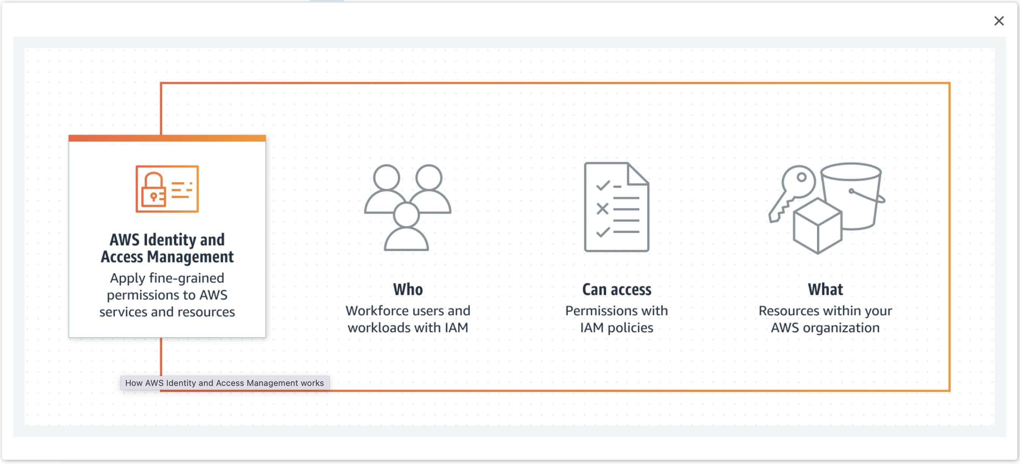
AWS IAM

Slide 71
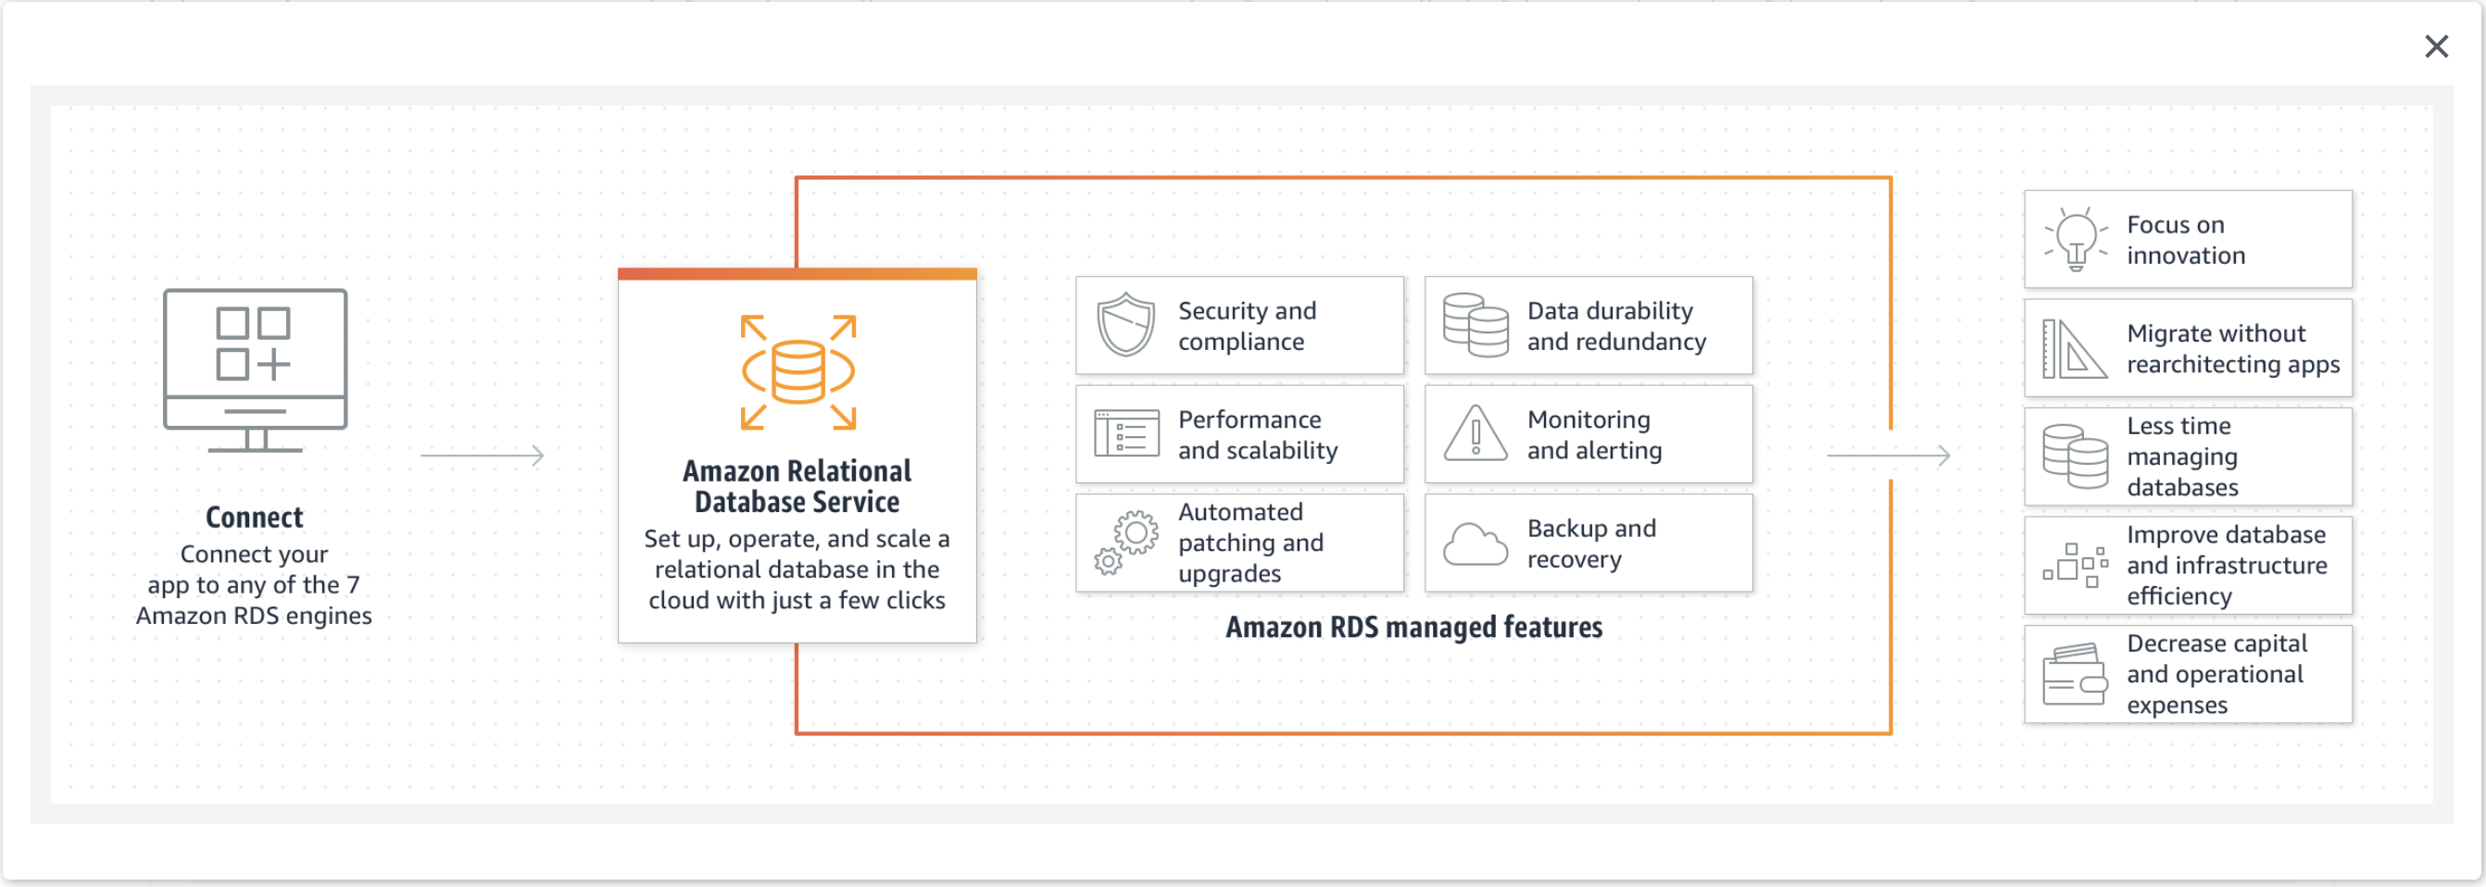
AWS RDS

Slide 72
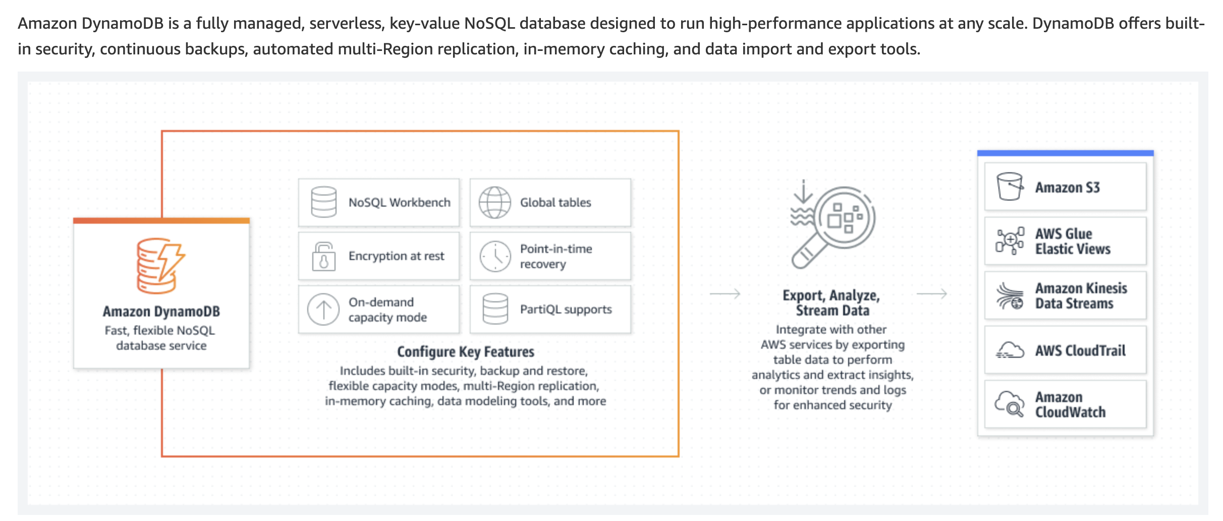
AWS DynamoDB

Slide 73
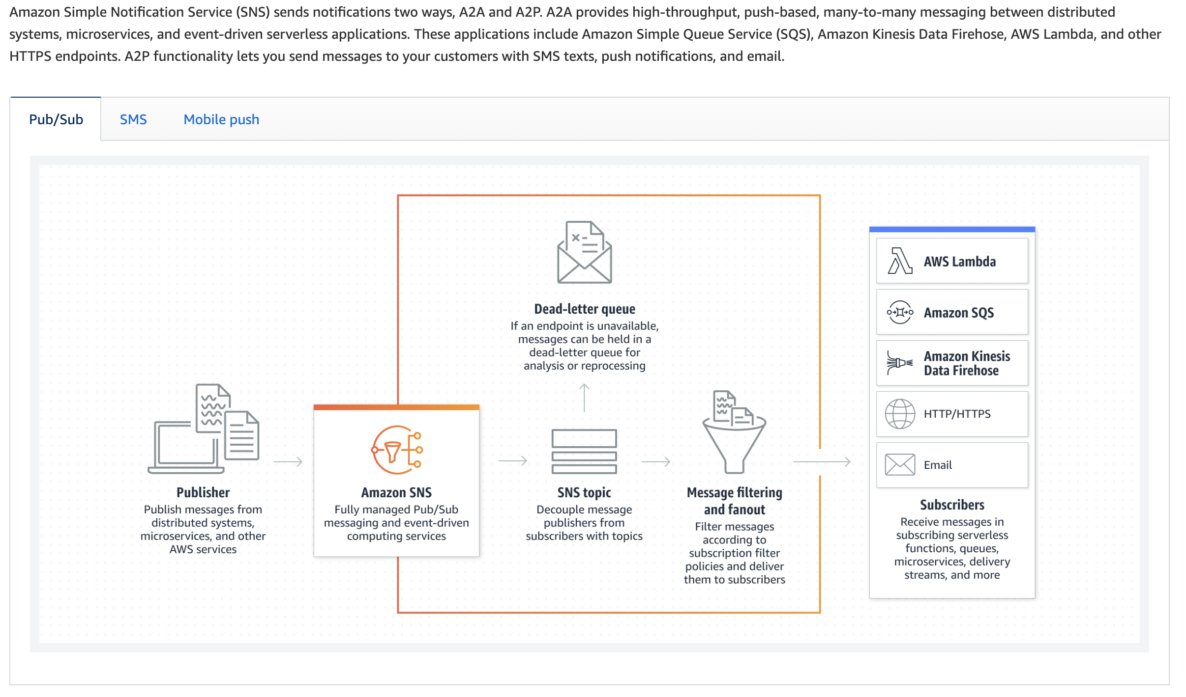
AWS SNS

Slide 74
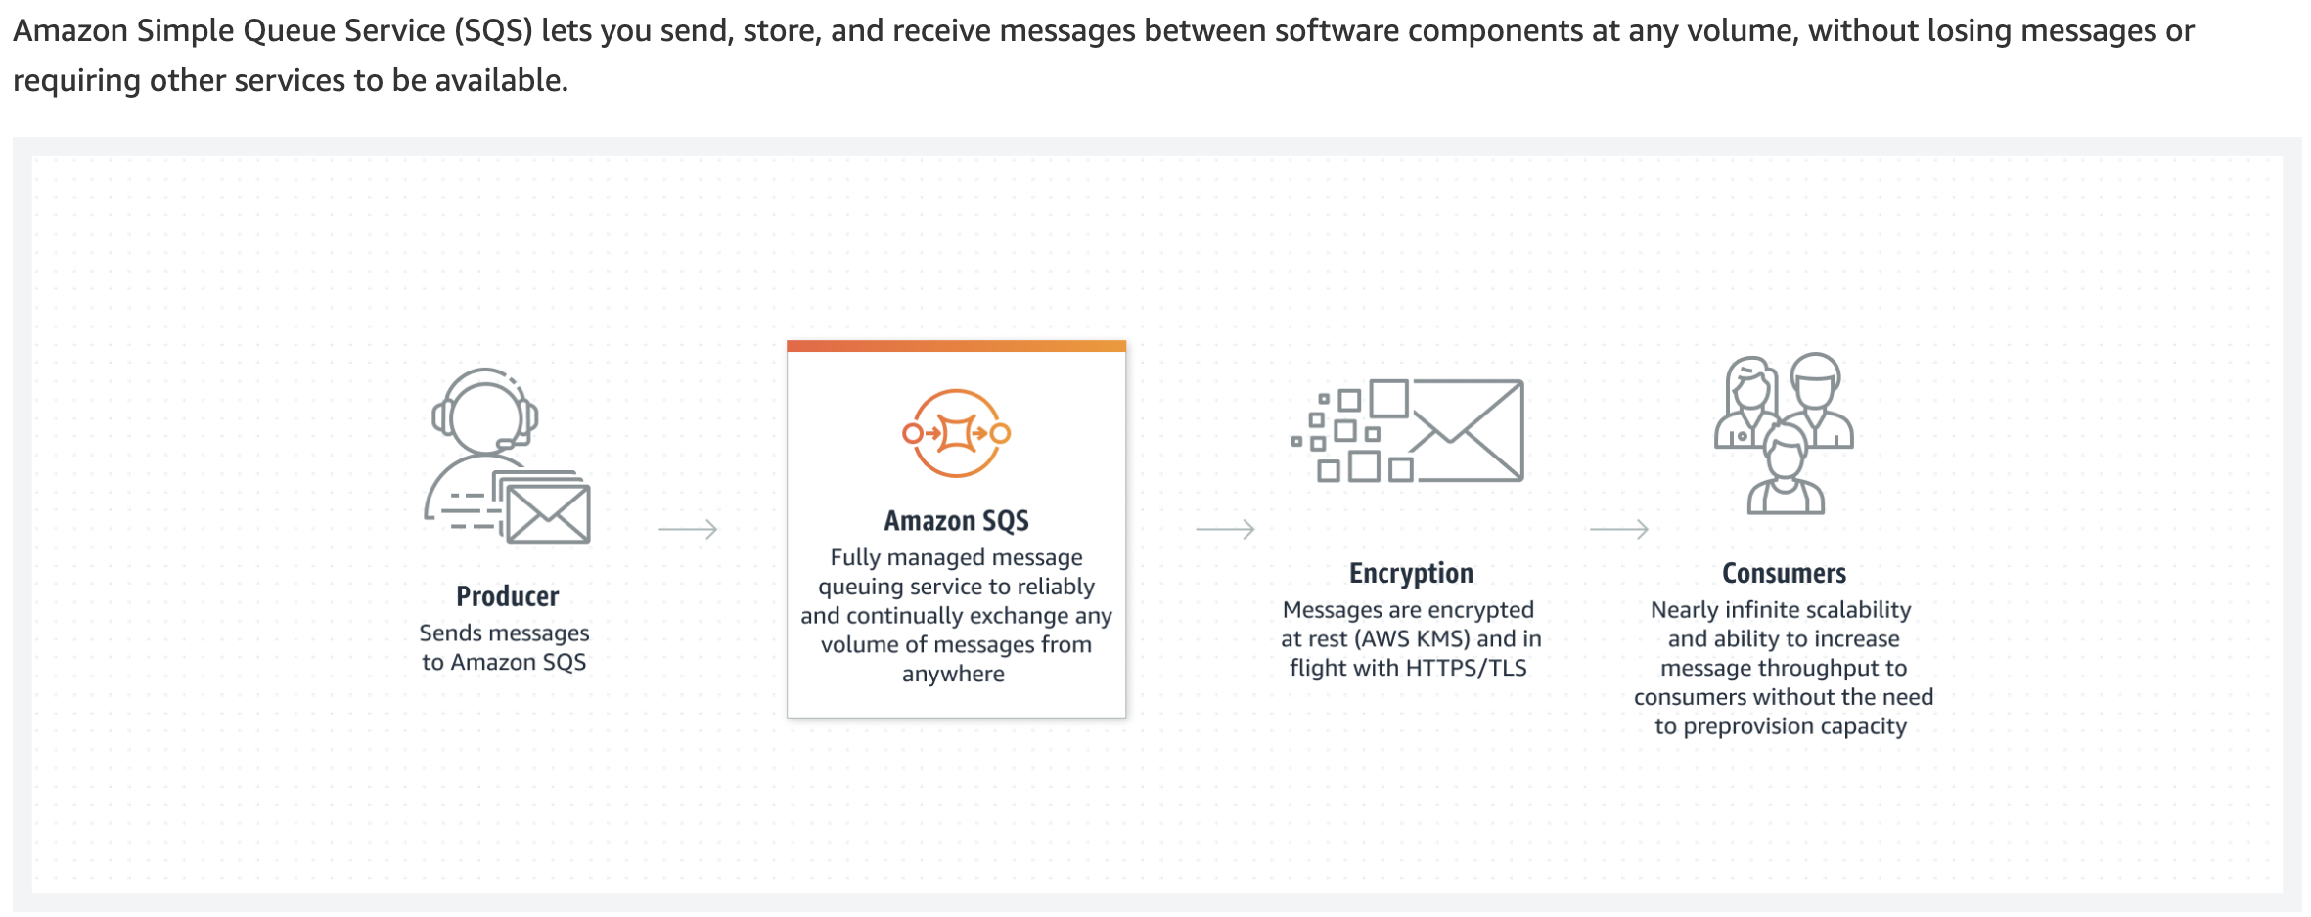
AWS SQS

Slide 75
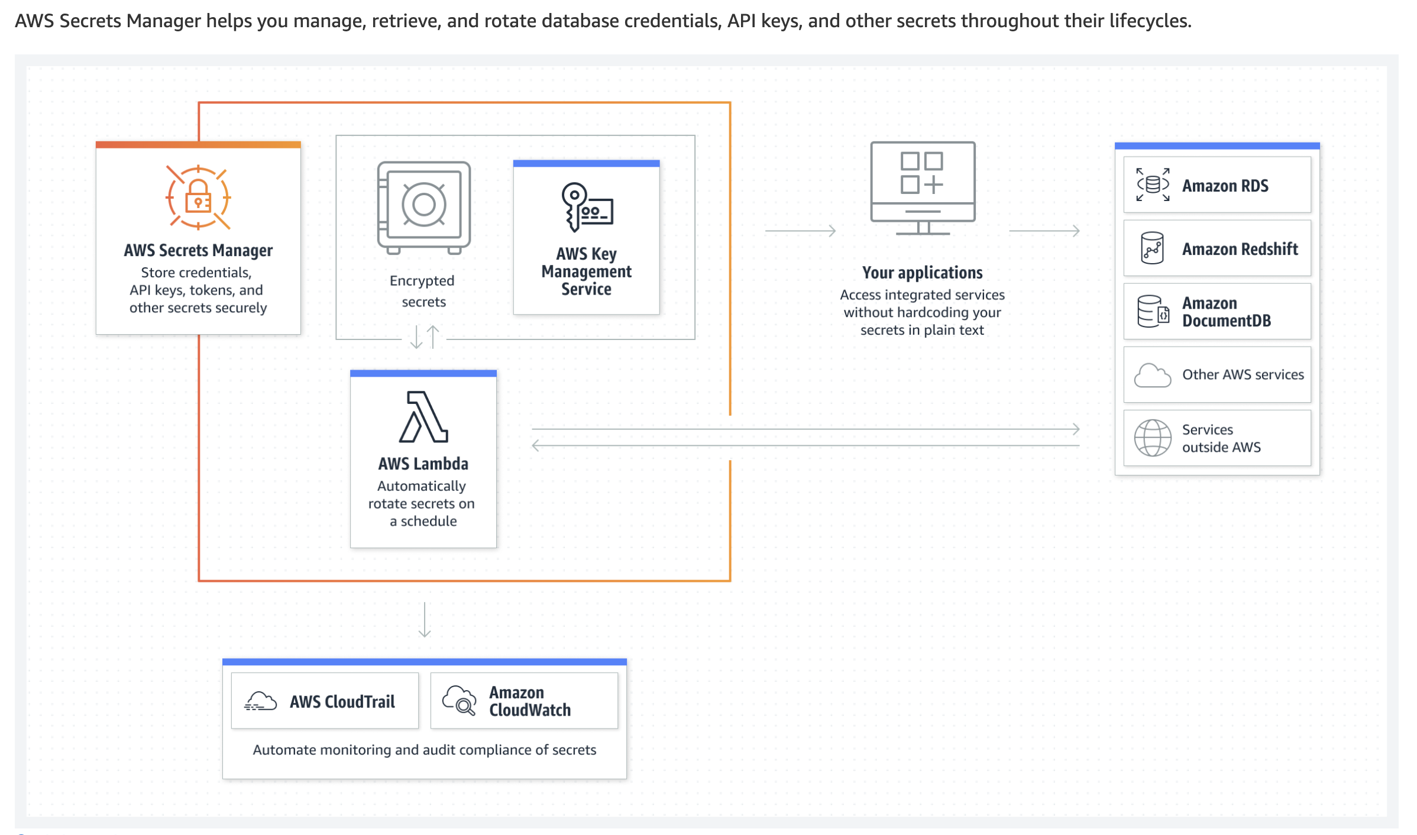
AWS Secrets Manager

Slide 76
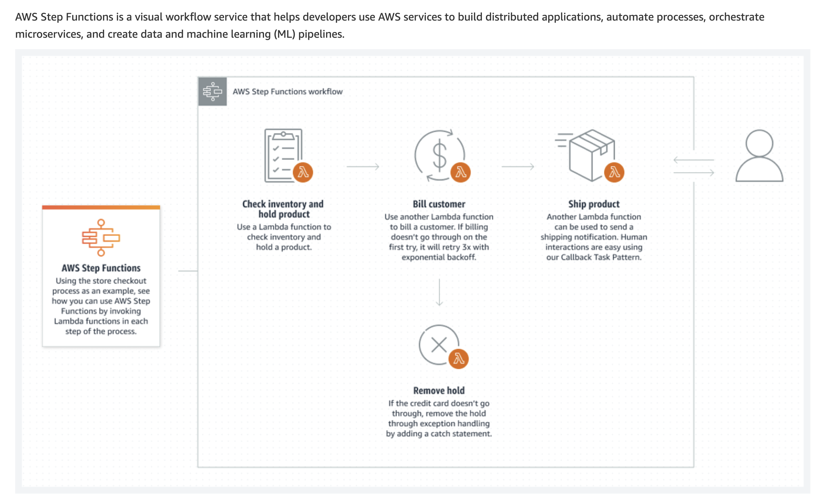
AWS Step Functions

Slide 77
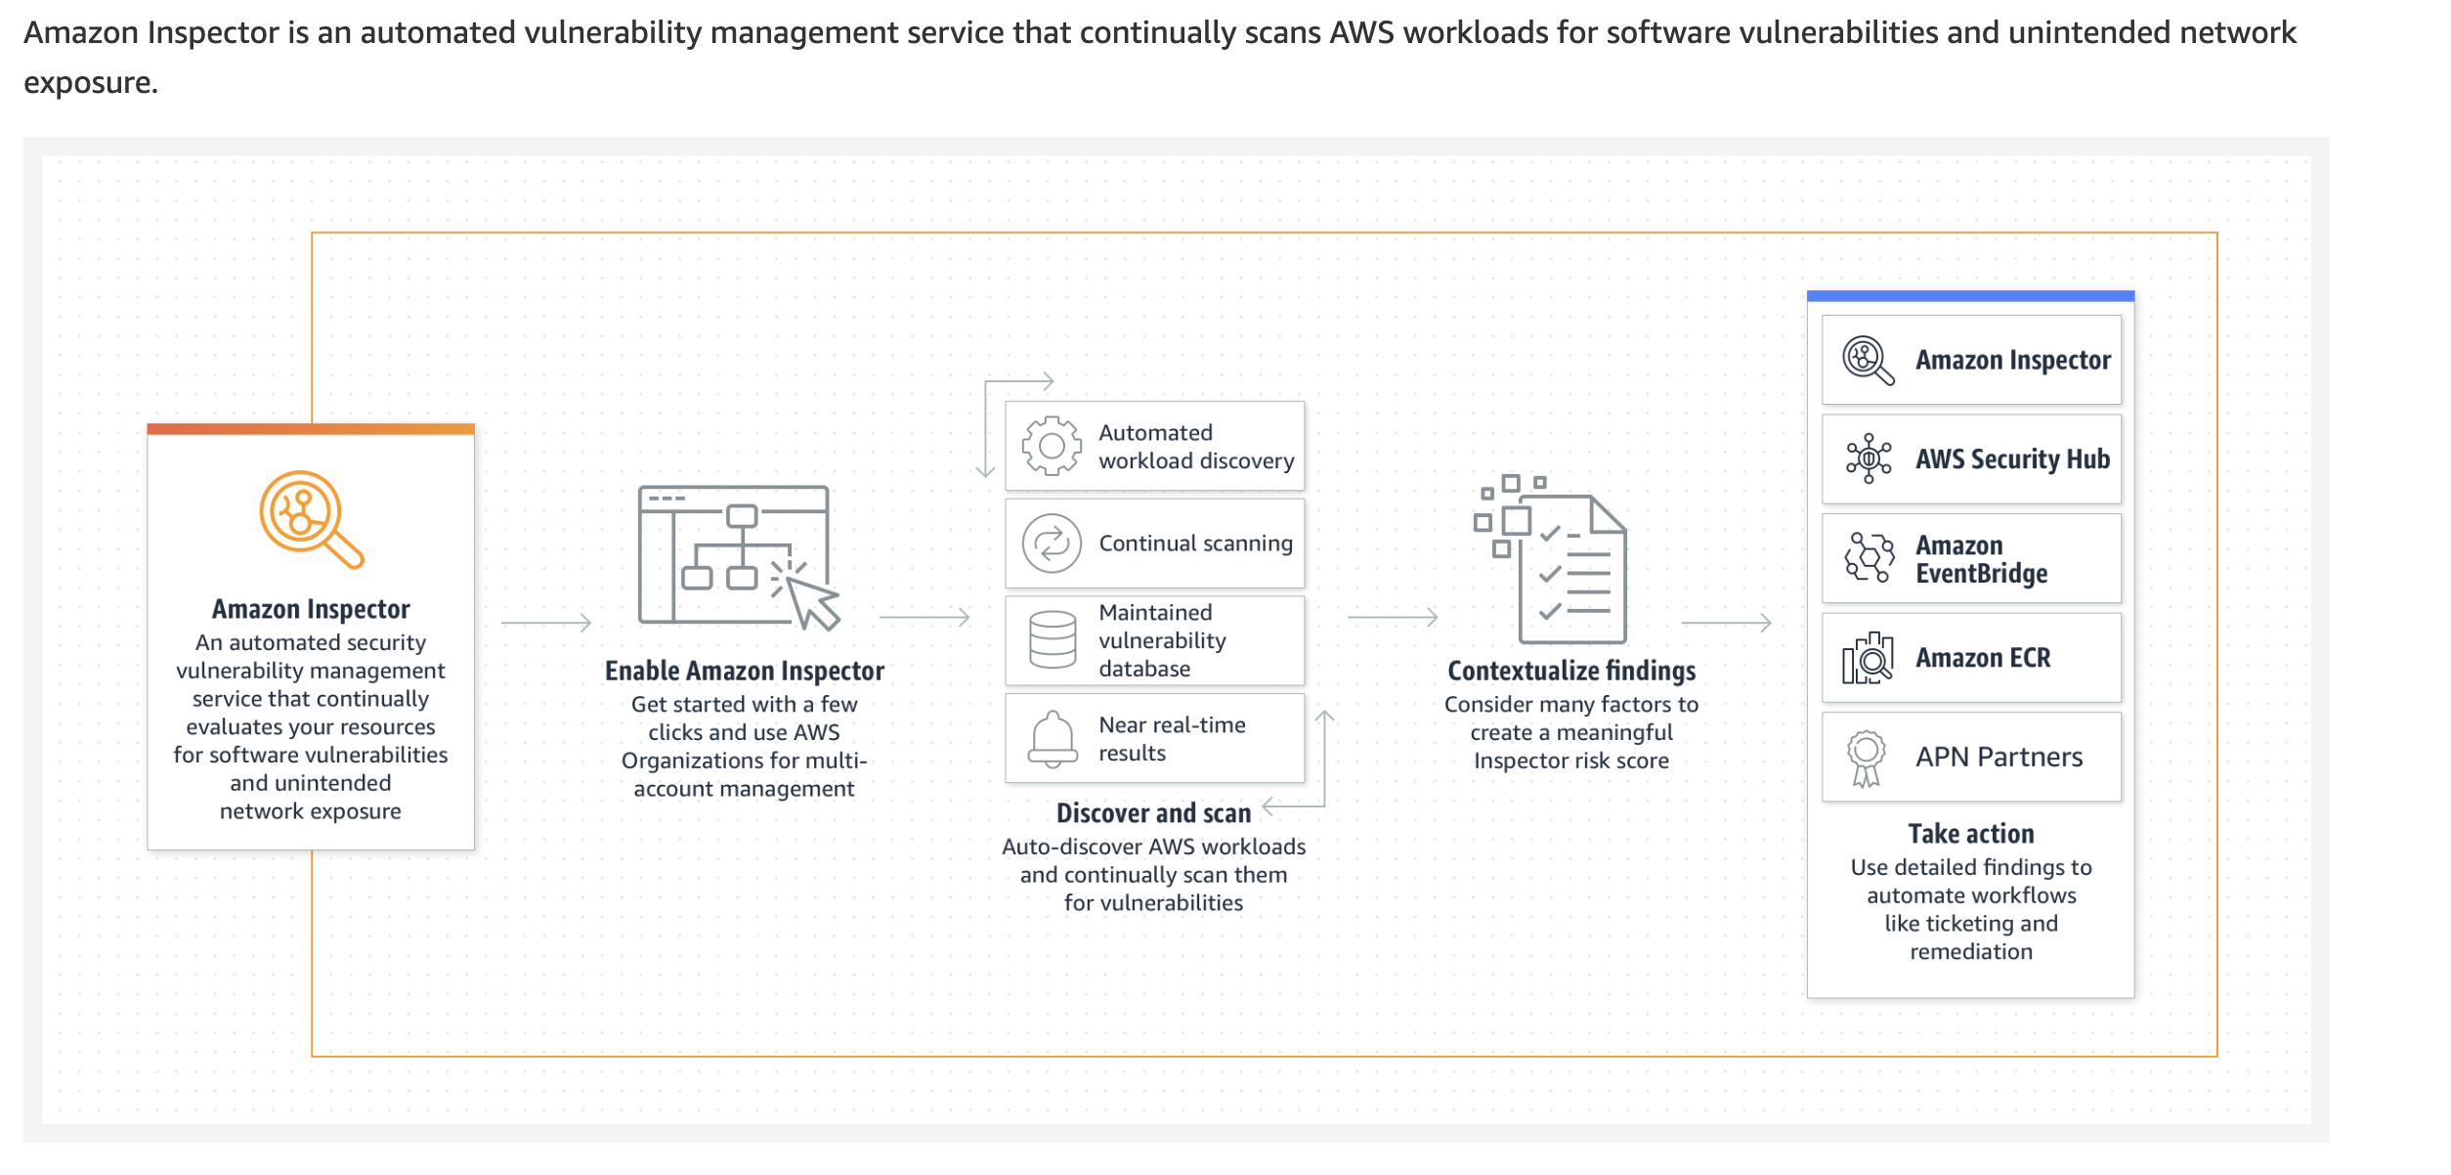
AWS Inspector

Slide 78
The DevOps team at a retail company has deployed its flagship application on EC2 instances using CodeDeploy and uses an RDS PostgreSQL database to store the data, while it uses DynamoDB to store the user sessions. As the Lead DevOps Engineer at the company, you would like the application to securely access RDS & DynamoDB.
How can you do this most securely?
Store the RDS credentials & DynamoDB credentials in Secrets Manager and create an IAM instance role for EC2 to access Secrets Manager
Store the RDS credentials in Secrets Manager and create an IAM instance role for EC2 to access Secrets Manager and DynamoDB
Store the RDS credentials in a DynamoDB table and create an IAM instance role for EC2 to access DynamoDB
Store IAM user credentials & RDS credentials in Secrets Manager and create an IAM instance role for EC2 to access Secrets Manager

Slide 79
The DevOps team at a retail company has deployed its flagship application on EC2 instances using CodeDeploy and uses an RDS PostgreSQL database to store the data, while it uses DynamoDB to store the user sessions. As the Lead DevOps Engineer at the company, you would like the application to securely access RDS & DynamoDB.
How can you do this most securely?
Store the RDS credentials & DynamoDB credentials in Secrets Manager and create an IAM instance role for EC2 to access Secrets Manager
Store the RDS credentials in Secrets Manager and create an IAM instance role for EC2 to access Secrets Manager and DynamoDB
Store the RDS credentials in a DynamoDB table and create an IAM instance role for EC2 to access DynamoDB
Store IAM user credentials & RDS credentials in Secrets Manager and create an IAM instance role for EC2 to access Secrets Manager

Slide 80
A financial services company is using security-hardened AMI due to strong regulatory compliance requirements. The company must be able to check every day for AMI vulnerabilities based on the newly disclosed ones through the common vulnerabilities and exposures (CVEs) program. Currently, all the instances are launched through an Auto Scaling group (ASG) leveraging the latest security-hardened AMI.
As a DevOps Engineer, how can you implement this while minimizing cost and application disruption?
Create a CloudWatch Event with a daily schedule. Invoke a Lambda Function that will start an AWS Inspector Run directly from the AMI reference in the API call. AWS Inspector will automatically launch an instance and terminate it upon assessment completion
Create a CloudWatch Event with a daily schedule, the target being a Step Function. The Step Function should launch an EC2 instance from the AMI and tag it with CheckVulnerabilities: True. The Step Function then starts an AMI assessment template using AWS Inspector and the above tag. Terminate the instance afterward
Create a CloudWatch Event with a daily schedule. Make the target of the rule being AWS Inspector and pass some extra data in the rule using the AMI ID to inspect. AWS Inspector will automatically launch an instance and terminate it upon assessment completion
Create a CloudWatch Event with a daily schedule, the target being a Lambda Function. Tag all the instances in your ASG with CheckVulnerabilities: True. The Lambda function should start an assessment in AWS Inspector targeting all instances having the tag

Slide 81
A financial services company is using security-hardened AMI due to strong regulatory compliance requirements. The company must be able to check every day for AMI vulnerabilities based on the newly disclosed ones through the common vulnerabilities and exposures (CVEs) program. Currently, all the instances are launched through an Auto Scaling group (ASG) leveraging the latest security-hardened AMI.
As a DevOps Engineer, how can you implement this while minimizing cost and application disruption?
Create a CloudWatch Event with a daily schedule. Invoke a Lambda Function that will start an AWS Inspector Run directly from the AMI reference in the API call. AWS Inspector will automatically launch an instance and terminate it upon assessment completion
Create a CloudWatch Event with a daily schedule, the target being a Step Function. The Step Function should launch an EC2 instance from the AMI and tag it with CheckVulnerabilities: True. The Step Function then starts an AMI assessment template using AWS Inspector and the above tag. Terminate the instance afterward
Create a CloudWatch Event with a daily schedule. Make the target of the rule being AWS Inspector and pass some extra data in the rule using the AMI ID to inspect. AWS Inspector will automatically launch an instance and terminate it upon assessment completion
Create a CloudWatch Event with a daily schedule, the target being a Lambda Function. Tag all the instances in your ASG with CheckVulnerabilities: True. The Lambda function should start an assessment in AWS Inspector targeting all instances having the tag

Slide 82
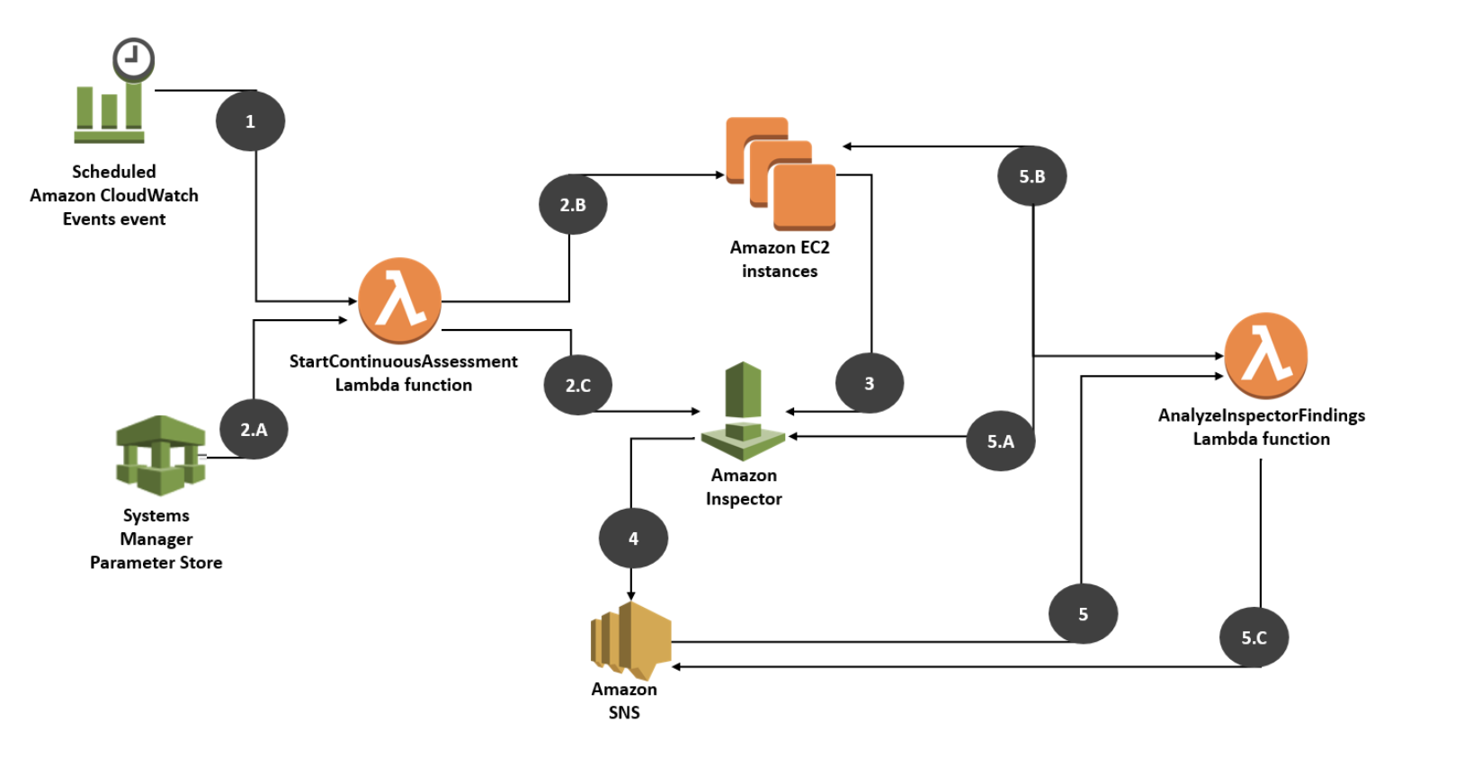

Slide 83
A health-care services company has strong regulatory requirements and it has come to light recently that some of the EBS volumes have not been encrypted. It is necessary for the company to monitor and audit compliance over time and alert the corresponding teams if unencrypted EBS volumes are detected.
How should a DevOps Engineer implement an alert for the unencrypted EBS volumes with the least administrative overhead?
Create an AWS Lambda Function that is triggered by a CloudWatch Event rule. The rule is monitoring for new EBS volumes being created. The Lambda function should send a notification to SNS in case of a compliance check
Create an AWS Config managed rule checking for EBS volume encryption. Connect the rule to an SNS topic to provide alerting
Create an AWS Config custom rule checking for the EC2 instances, and their EBS attachments. Connect the rule to an SNS topic to provide alerting
Create an AWS Config managed rule checking for EBS volume encryption. Use a CloudWatch Event rule to provide alerting

Slide 84
Incident and Event Response

Slide 85
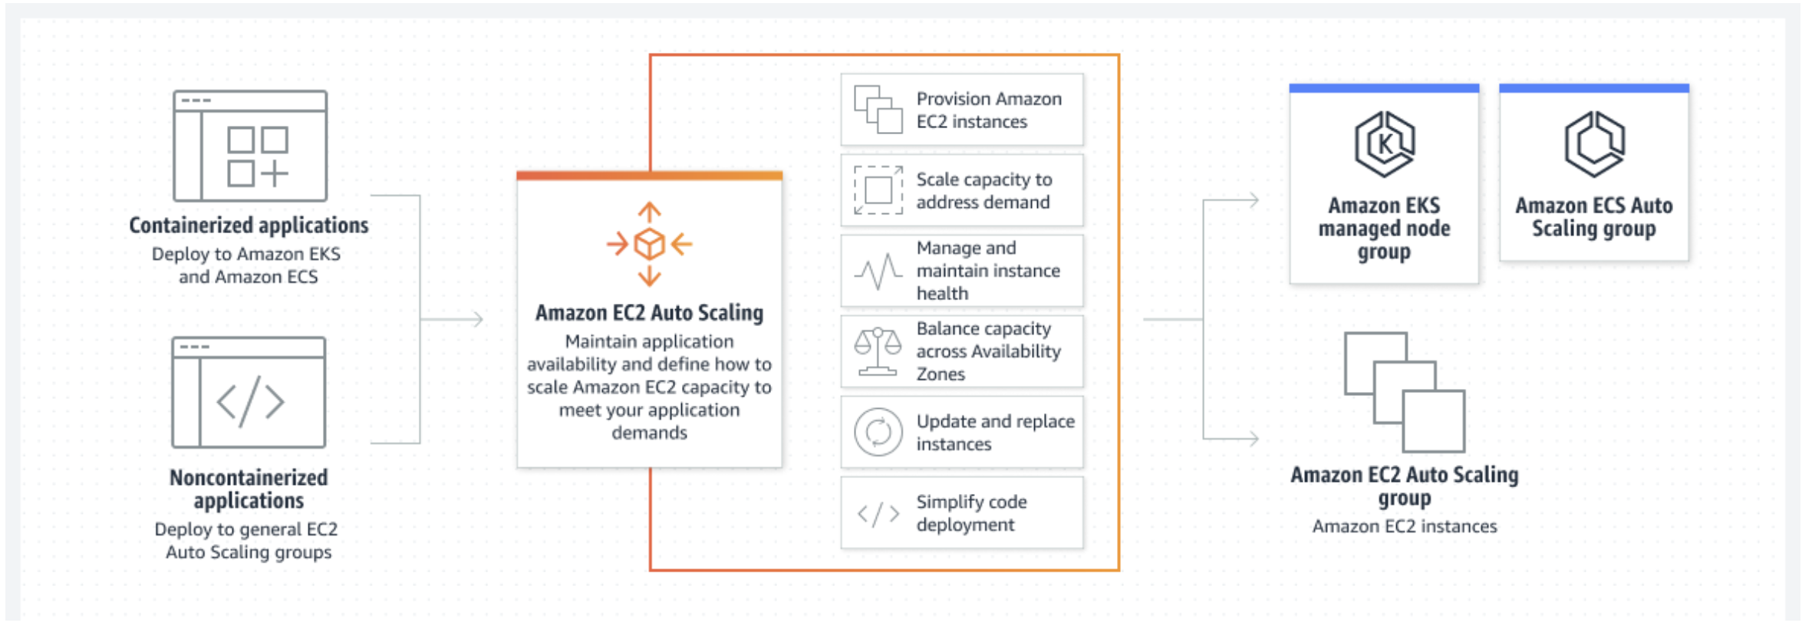
EC2 Autoscaling

Slide 86
A social media company is running its flagship application via an Auto-Scaling group (ASG) which has 15 EC2 instances spanning across 3 Availability Zones (AZs). The current average CPU utilization of the group sits at 15% off-peak time. During peak time, it goes all the way to 45%, and these peak times happen predictably during business hours. The company has hired you as an AWS Certified DevOps Engineer Professional to build a solution for this requirement.
How can you improve the instance utilization while reducing cost and maintaining application availability?
Create a Lambda function that terminates 9 instances at the end of business hours. Create a second Lambda function that creates instances when peak time starts. Schedule the functions using CloudWatch Events
Use a CloudFormation UpdatePolicy to define how the Auto Scaling Group should behave off and on peaks. Ensure the ASG invokes the CloudFormation using SNS notifications relay
Create a scaling policy that tracks the CPU utilization with a target of 75%. Create a scheduled action that increases the number of minimum instances to 6 during peak times and a second scheduled action that reduces the number of minimum instances to 3 off-peak times
Create a scaling policy that tracks the CPU utilization with a target of 75%. Create a scheduled action that invokes a Lambda function which will terminate 9 instances after peak times

Slide 87
A social media company is running its flagship application via an Auto-Scaling group (ASG) which has 15 EC2 instances spanning across 3 Availability Zones (AZs). The current average CPU utilization of the group sits at 15% off-peak time. During peak time, it goes all the way to 45%, and these peak times happen predictably during business hours. The company has hired you as an AWS Certified DevOps Engineer Professional to build a solution for this requirement.
How can you improve the instance utilization while reducing cost and maintaining application availability?
Create a Lambda function that terminates 9 instances at the end of business hours. Create a second Lambda function that creates instances when peak time starts. Schedule the functions using CloudWatch Events
Use a CloudFormation UpdatePolicy to define how the Auto Scaling Group should behave off and on peaks. Ensure the ASG invokes the CloudFormation using SNS notifications relay
Create a scaling policy that tracks the CPU utilization with a target of 75%. Create a scheduled action that increases the number of minimum instances to 6 during peak times and a second scheduled action that reduces the number of minimum instances to 3 off-peak times
Create a scaling policy that tracks the CPU utilization with a target of 75%. Create a scheduled action that invokes a Lambda function which will terminate 9 instances after peak times

Slide 88
The engineering team at a multi-national retail company is deploying its flagship web application onto an Auto Scaling Group using CodeDeploy. The team has chosen a strategy of a rolling update so that instances are updated in small batches in the ASG. The ASG has five instances running. At the end of the deployment, it seems that three instances are running the new version of the application, while the other two are running the old version. CodeDeploy is reporting a successful deployment.
As a DevOps Engineer, what is the most likely reason that you would attribute for this issue?
A CloudWatch alarm has been triggered during the deployment
Two instances are having an IAM permissions issue and cannot download the new code revision from S3
The auto-scaling group launch configuration has not been updated
Two new instances were created during the deployment

Slide 89
The engineering team at a multi-national retail company is deploying its flagship web application onto an Auto Scaling Group using CodeDeploy. The team has chosen a strategy of a rolling update so that instances are updated in small batches in the ASG. The ASG has five instances running. At the end of the deployment, it seems that three instances are running the new version of the application, while the other two are running the old version. CodeDeploy is reporting a successful deployment.
As a DevOps Engineer, what is the most likely reason that you would attribute for this issue?
A CloudWatch alarm has been triggered during the deployment
Two instances are having an IAM permissions issue and cannot download the new code revision from S3
The auto-scaling group launch configuration has not been updated
Two new instances were created during the deployment

Slide 90
A Big Data analytics company has deployed a stream processing application to read records from Kinesis Data Streams configured with multiple shards. The application is running on one EC2 instance. It seems that the consuming application is lagging under a large load and therefore records are not processed in time and eventually dropped from the stream.
As a DevOps Engineer, you have been tasked with improving the reliability of this application with minimal changes, what should you do? (Select two)
Migrate the application to AWS Lambda
Decrease the numbers of shards in Kinesis to decrease the load
Increase the stream data retention period
Run the application in an Auto Scaling Group and scale based on the CloudWatch Metric MillisBehindLatest
Increase the number of shards in Kinesis to increase throughput

Slide 91
A Big Data analytics company has deployed a stream processing application to read records from Kinesis Data Streams configured with multiple shards. The application is running on one EC2 instance. It seems that the consuming application is lagging under a large load and therefore records are not processed in time and eventually dropped from the stream.
As a DevOps Engineer, you have been tasked with improving the reliability of this application with minimal changes, what should you do? (Select two)
Migrate the application to AWS Lambda
Decrease the numbers of shards in Kinesis to decrease the load
Increase the stream data retention period
Run the application in an Auto Scaling Group and scale based on the CloudWatch Metric MillisBehindLatest
Increase the number of shards in Kinesis to increase throughput

Slide 92
A retail company is storing the users' information along with their purchase history in a DynamoDB table and it has also enabled the DynamoDB Streams. Three use cases are implemented for this table: a Lambda function reads the stream to send emails for new users subscriptions, another Lambda function which sends an email after a user has done their first purchase and finally the last Lambda function which awards discounts to users every 10 purchase. When there is a high volume of data on your DynamoDB table, the Lambda functions are experiencing a throttling issue. As you plan on adding future Lambda functions to read from that stream, you need to update the existing solution.
As a DevOps Engineer, which of the following options would you recommend?
Create a DynamoDB DAX cluster to cache the reads
Increase the RCUs on your DynamoDB table to avoid throttling issues
Increase the memory on the Lambda function so that they have an increased vCPU allocation and process the data faster while making fewer requests to DynamoDB
Create a new Lambda function that will read from the stream and pass on the payload to SNS. Have the other three and upcoming Lambda functions directly read from the SNS topic

Slide 93
A retail company is storing the users' information along with their purchase history in a DynamoDB table and it has also enabled the DynamoDB Streams. Three use cases are implemented for this table: a Lambda function reads the stream to send emails for new users subscriptions, another Lambda function which sends an email after a user has done their first purchase and finally the last Lambda function which awards discounts to users every 10 purchase. When there is a high volume of data on your DynamoDB table, the Lambda functions are experiencing a throttling issue. As you plan on adding future Lambda functions to read from that stream, you need to update the existing solution.
As a DevOps Engineer, which of the following options would you recommend?
Create a DynamoDB DAX cluster to cache the reads
Increase the RCUs on your DynamoDB table to avoid throttling issues
Increase the memory on the Lambda function so that they have an increased vCPU allocation and process the data faster while making fewer requests to DynamoDB
Create a new Lambda function that will read from the stream and pass on the payload to SNS. Have the other three and upcoming Lambda functions directly read from the SNS topic

Slide 94
High Availability, Fault Tolerance and Disaster Recovery

Slide 95
AWS Regions and Availability Zones
AWS has the concept of a Region, which is a physical location around the world where we cluster data centers. We call each group of logical data centers an Availability Zone. Each AWS Region consists of a minimum of three, isolated, and physically separate AZs within a geographic area.

Slide 96
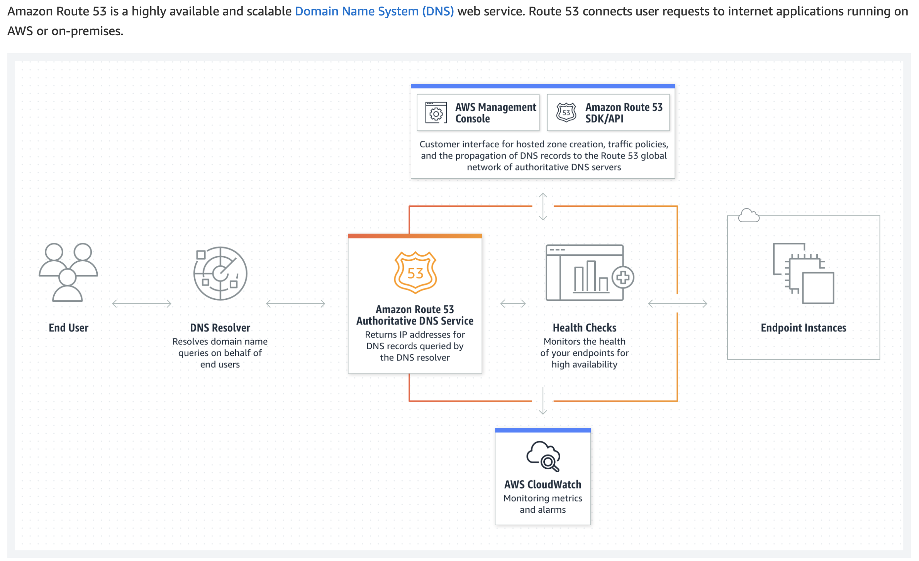
Route53

Slide 97
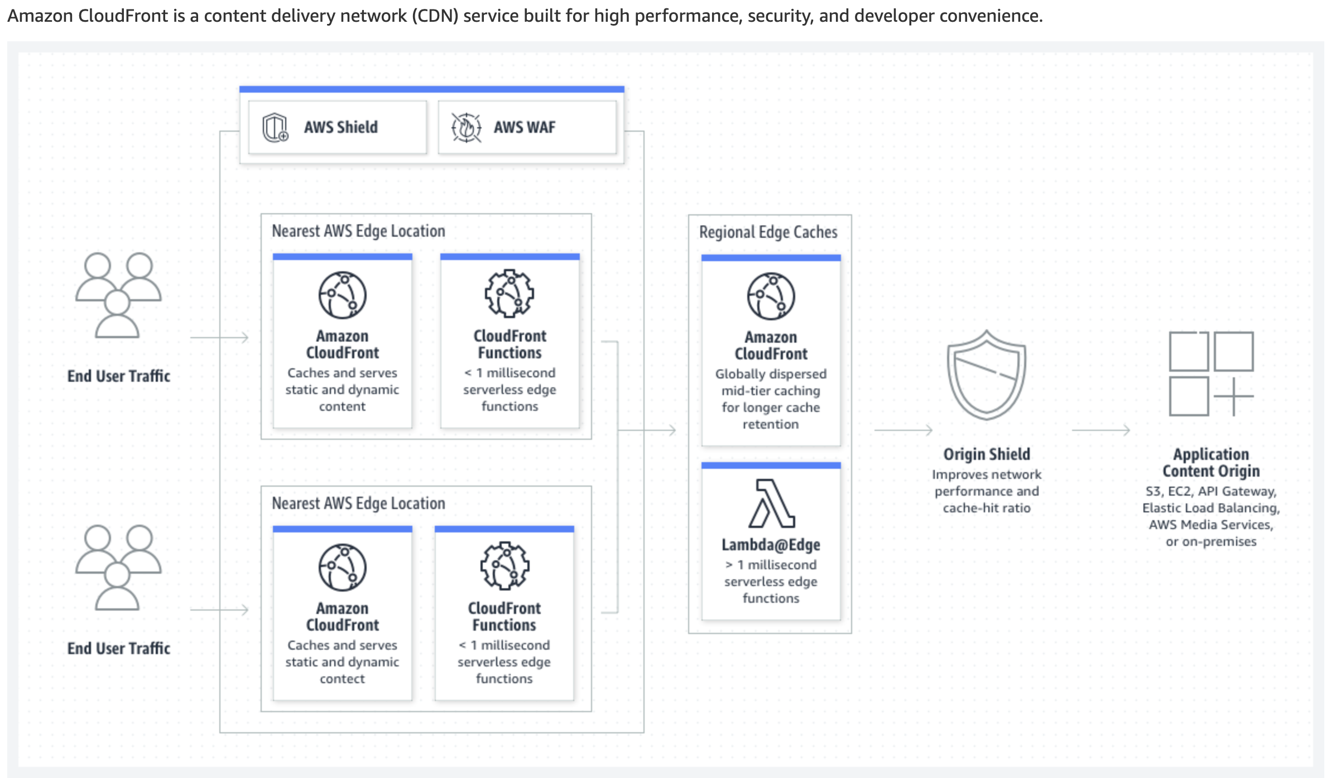
AWS Cloudfront

Slide 98
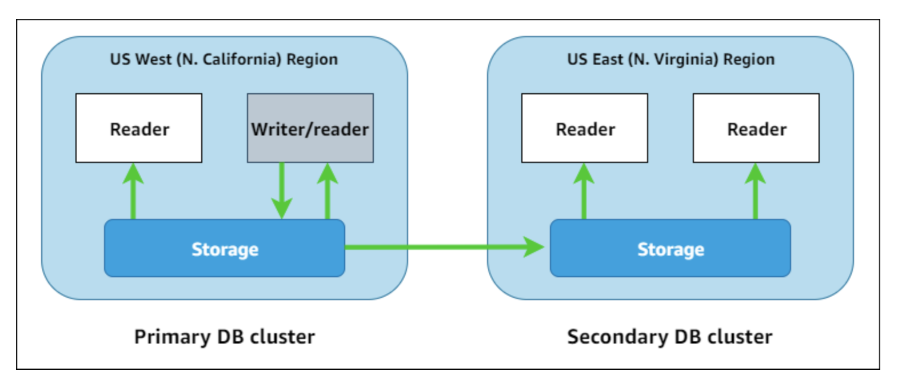
RDS Global

Slide 99
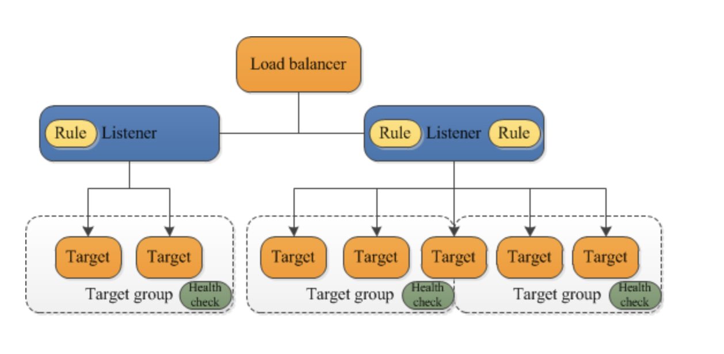
Application Load Balancer

Slide 100
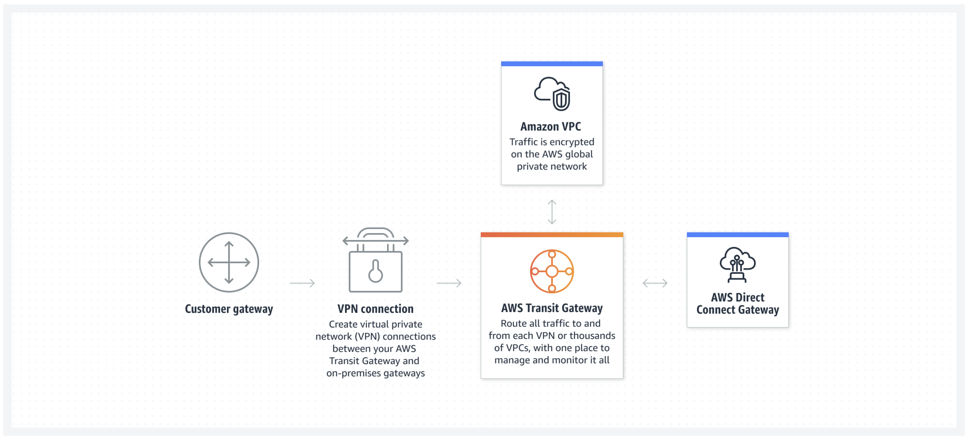
Transit Gateway

Slide 101
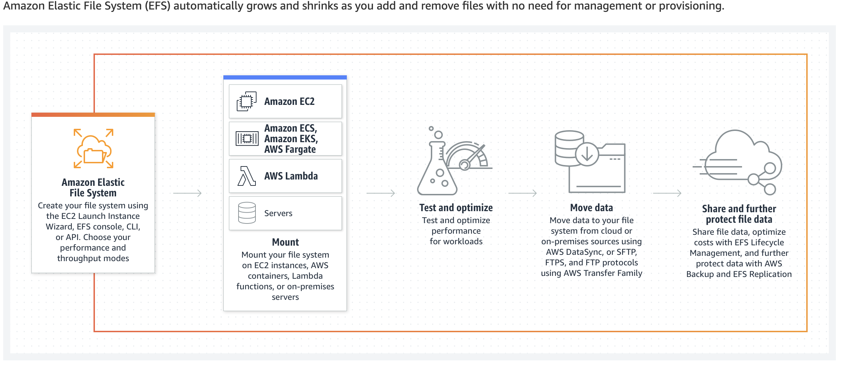
EFS

Slide 102
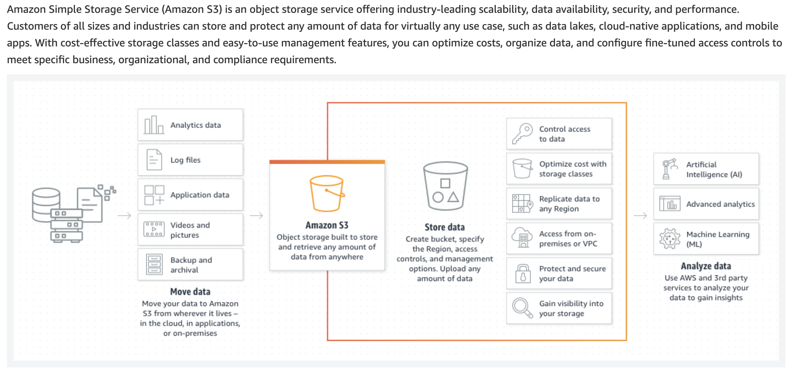
EFS

Slide 103
A media streaming solutions company has deployed an application that allows its customers to view movies in real-time. The application connects to an Amazon Aurora database, and the entire stack is currently deployed in the United States. The company has plans to expand to Europe and Asia for its operations. It needs the movies table to be accessible globally but needs the users and movies_watched table to be regional only.
As a DevOps Engineer, how would you implement this with minimal application refactoring?
Use an Amazon Aurora Global Database for the movies table and use Amazon Aurora for the users and movies_watched tables
Use an Amazon Aurora Global Database for the movies table and use DynamoDB for the users and movies_watched tables
Use a DynamoDB Global Table for the movies table and use Amazon Aurora for the users and movies_watched tables
Use a DynamoDB Global Table for the movies table and use DynamoDB for the users and movies_watched tables

Slide 104
A media streaming solutions company has deployed an application that allows its customers to view movies in real-time. The application connects to an Amazon Aurora database, and the entire stack is currently deployed in the United States. The company has plans to expand to Europe and Asia for its operations. It needs the movies table to be accessible globally but needs the users and movies_watched table to be regional only.
As a DevOps Engineer, how would you implement this with minimal application refactoring?
Use an Amazon Aurora Global Database for the movies table and use Amazon Aurora for the users and movies_watched tables
Use an Amazon Aurora Global Database for the movies table and use DynamoDB for the users and movies_watched tables
Use a DynamoDB Global Table for the movies table and use Amazon Aurora for the users and movies_watched tables
Use a DynamoDB Global Table for the movies table and use DynamoDB for the users and movies_watched tables

Slide 105
A global health-care company has an EFS filesystem being used in eu-west-1. The company would like to plan for a disaster recovery strategy and backup that EFS file system in ap-southeast-2. It needs to have a hot copy of the data so that the applications can be re-deployed in ap-southeast-2 with a minimum RPO and RTO. The VPCs in each region are not peered with each other.
How should a DevOps engineer implement a solution for this use-case?
Create a CloudWatch Event hourly rule that triggers an AWS Batch cluster in eu-west-1 to perform an incremental replication. Replicate the data into Amazon S3 in another region. Create an EC2 replication cluster in ap-southeast-2 that reads from Amazon S3 and copies the files into a standby EFS cluster
Create a CloudWatch Event hourly rule that triggers an AWS Batch cluster in eu-west-1 to perform an incremental replication. Replicate the data into Amazon S3 in another region. Create a Lambda Function in ap-southeast-2 for PUT on Amazon S3 and triggers an SSM Run Command to copy the files from S3 into EFS
Create a replication cluster managed by EC2 with Auto Scaling in eu-west-1. Scale according to a Custom Metric you would publish with the application representing the lag in file reads. Replicate the data into Amazon S3 in ap-southeast-2. Create another replication cluster in ap-southeast-2 that reads from Amazon S3 and copies the files into a standby EFS cluster
Create a replication cluster managed by EC2 with Auto Scaling in eu-west-1. Scale according to a Custom Metric you would publish with the application representing the lag in file reads. Create a standby EFS cluster in ap-southeast-2 and mount it on the same EC2 cluster. Let the replication software perform EFS to EFS replication

Slide 106
A global health-care company has an EFS filesystem being used in eu-west-1. The company would like to plan for a disaster recovery strategy and backup that EFS file system in ap-southeast-2. It needs to have a hot copy of the data so that the applications can be re-deployed in ap-southeast-2 with a minimum RPO and RTO. The VPCs in each region are not peered with each other.
How should a DevOps engineer implement a solution for this use-case?
Create a CloudWatch Event hourly rule that triggers an AWS Batch cluster in eu-west-1 to perform an incremental replication. Replicate the data into Amazon S3 in another region. Create an EC2 replication cluster in ap-southeast-2 that reads from Amazon S3 and copies the files into a standby EFS cluster
Create a CloudWatch Event hourly rule that triggers an AWS Batch cluster in eu-west-1 to perform an incremental replication. Replicate the data into Amazon S3 in another region. Create a Lambda Function in ap-southeast-2 for PUT on Amazon S3 and triggers an SSM Run Command to copy the files from S3 into EFS
Create a replication cluster managed by EC2 with Auto Scaling in eu-west-1. Scale according to a Custom Metric you would publish with the application representing the lag in file reads. Replicate the data into Amazon S3 in ap-southeast-2. Create another replication cluster in ap-southeast-2 that reads from Amazon S3 and copies the files into a standby EFS cluster
Create a replication cluster managed by EC2 with Auto Scaling in eu-west-1. Scale according to a Custom Metric you would publish with the application representing the lag in file reads. Create a standby EFS cluster in ap-southeast-2 and mount it on the same EC2 cluster. Let the replication software perform EFS to EFS replication

Slide 107
A multi-national retail company is planning for disaster recovery and needs the data to be stored in Amazon S3 in two different regions that are in different continents. The data is written at a high rate of 10000 objects per second. For regulatory reasons, the data also needs to be encrypted in transit and at rest. The company has hired you as an AWS Certified DevOps Engineer Professional to build a solution for this requirement.
Which of the following solutions would you recommend?
Create a bucket policy to create a condition for Denying any request that is "aws:SecureTransport": "true". Encrypt the objects at rest using SSE-S3. Setup Cross-Region Replication
Create a bucket policy to create a condition for Denying any request that is "aws:SecureTransport": "false". Encrypt the objects at rest using SSE-S3. Setup Cross-Region Replication
Create a bucket policy to create a condition for Denying any request that is "aws:SecureTransport": "true". Encrypt the objects at rest using SSE-KMS. Setup Cross-Region Replication
Create a bucket policy to create a condition for Denying any request that is "aws:SecureTransport": "false". Encrypt the objects at rest using SSE-KMS. Setup Cross-Region Replication

Slide 108
A multi-national retail company is planning for disaster recovery and needs the data to be stored in Amazon S3 in two different regions that are in different continents. The data is written at a high rate of 10000 objects per second. For regulatory reasons, the data also needs to be encrypted in transit and at rest. The company has hired you as an AWS Certified DevOps Engineer Professional to build a solution for this requirement.
Which of the following solutions would you recommend?
Create a bucket policy to create a condition for Denying any request that is "aws:SecureTransport": "true". Encrypt the objects at rest using SSE-S3. Setup Cross-Region Replication
Create a bucket policy to create a condition for Denying any request that is "aws:SecureTransport": "false". Encrypt the objects at rest using SSE-S3. Setup Cross-Region Replication
Create a bucket policy to create a condition for Denying any request that is "aws:SecureTransport": "true". Encrypt the objects at rest using SSE-KMS. Setup Cross-Region Replication
Create a bucket policy to create a condition for Denying any request that is "aws:SecureTransport": "false". Encrypt the objects at rest using SSE-KMS. Setup Cross-Region Replication

Slide 109
As a DevOps Engineer at a data analytics company, you're deploying a web application on EC2 using an Auto Scaling group. The data is stored in RDS MySQL Multi-AZ, and a caching layer using ElastiCache. The application configuration takes time and currently needs over 20 minutes to warm up. 10 of those minutes are spent installing and configuring the web application, and another 10 minutes are spent warming up the local instance data cache.
What can be done to improve the performance of the setup?
Create an AMI that contains the web application and a copy of the local data cache. Configure the dynamic part at runtime an EC2 User Data script
Migrate from ElastiCache to DynamoDB. Create an AMI that contains the web application. Configure the dynamic part at runtime using an EC2 User Data script
Create an AMI that contains the web application. Configure the dynamic part at runtime using an EC2 User Data script
Create an AMI that contains the web application. Configure the dynamic part at runtime using an EC2 User Data script. Use AWS Lambda to configure the instance local cache at boot time

Slide 110
As a DevOps Engineer at a data analytics company, you're deploying a web application on EC2 using an Auto Scaling group. The data is stored in RDS MySQL Multi-AZ, and a caching layer using ElastiCache. The application configuration takes time and currently needs over 20 minutes to warm up. 10 of those minutes are spent installing and configuring the web application, and another 10 minutes are spent warming up the local instance data cache.
What can be done to improve the performance of the setup?
Create an AMI that contains the web application and a copy of the local data cache. Configure the dynamic part at runtime an EC2 User Data script
Migrate from ElastiCache to DynamoDB. Create an AMI that contains the web application. Configure the dynamic part at runtime using an EC2 User Data script
Create an AMI that contains the web application. Configure the dynamic part at runtime using an EC2 User Data script
Create an AMI that contains the web application. Configure the dynamic part at runtime using an EC2 User Data script. Use AWS Lambda to configure the instance local cache at boot time

Slide 111
As the Lead DevOps Engineer at a retail company, you have a Spring boot web application running in an Auto Scaling group and behind an Application Load Balancer. You must collect the logs before an instance is terminated to perform log analytics later on. It's also necessary to collect all the access logs. The analysis of these logs should be performed at a minimal cost, and only need to be run from time to time.
Which of the following options would you suggest to implement the MOST cost-optimal solution for this requirement? (Select three)
Analyze the logs using AWS Athena
Enable Access Logs at the Application Load Balancer level
Enable Access Logs at the Target Group level
Create an Auto Scaling Group Lifecycle Hook for the terminate action. Create a CloudWatch Event rule for that lifecycle hook and invoke a Lambda function. The Lambda function should use an SSM Run Command to extract the application logs and store them in S3
Create an Auto Scaling Group Lifecycle Hook for the terminate action. Create a CloudWatch Event rule for that lifecycle hook and invoke a Lambda function. The Lambda function should use an SSM Run Command to install the CloudWatch Logs Agent and push the applications logs in S3
Analyze the logs using an EMR cluster

Slide 112
As the Lead DevOps Engineer at a retail company, you have a Spring boot web application running in an Auto Scaling group and behind an Application Load Balancer. You must collect the logs before an instance is terminated to perform log analytics later on. It's also necessary to collect all the access logs. The analysis of these logs should be performed at a minimal cost, and only need to be run from time to time.
Which of the following options would you suggest to implement the MOST cost-optimal solution for this requirement? (Select three)
Analyze the logs using AWS Athena
Enable Access Logs at the Application Load Balancer level
Enable Access Logs at the Target Group level
Create an Auto Scaling Group Lifecycle Hook for the terminate action. Create a CloudWatch Event rule for that lifecycle hook and invoke a Lambda function. The Lambda function should use an SSM Run Command to extract the application logs and store them in S3
Create an Auto Scaling Group Lifecycle Hook for the terminate action. Create a CloudWatch Event rule for that lifecycle hook and invoke a Lambda function. The Lambda function should use an SSM Run Command to install the CloudWatch Logs Agent and push the applications logs in S3
Analyze the logs using an EMR cluster

